Slide 1
Emotional and Social Intelligence
Mushtak Al-Atabi
Provost and CEO
Heriot-Watt University Malaysia

Slide 2
Outline

Slide 3
By 2030
800 Million could lose their jobs
375 Million will change jobs
Source: McKinsey Global Institute analysis

Slide 4
Ethics
Agricultural Revolution
Industrial Revolution
Digital Revolution
Human Revolution
Ethics
Purpose
Emotional Labour
Purpose
Relationships
Relationships
Empathy
Empathy
Awareness
Awareness
Creativity
Critical Thinking
Cognitive Labour
Creativity
Critical Thinking
Optimisation
Analysis
Memory
Precision work
Physical Labour
Precision work
Skilled work
Manual work
1870
3500 BC
Invention of the Wheel
1997
Deep Blue Beats Garry Kasparov
Now
Industry 4.0
John Henry’s Death
Replaced/Replaceable by Machine

Slide 5
Mental Wellbeing Facts
Source: World Health Statistics Report. WHO. 2016
Depression and anxiety are estimated to affect nearly 1 in 10 people on the planet.
In 2012, there were over 800,000 estimated suicide deaths worldwide.
Globally, among young adults aged 15–29 years suicide accounts for 8.5% of all deaths and is the second leading cause of death in this group after road traffic injuries.

Slide 7
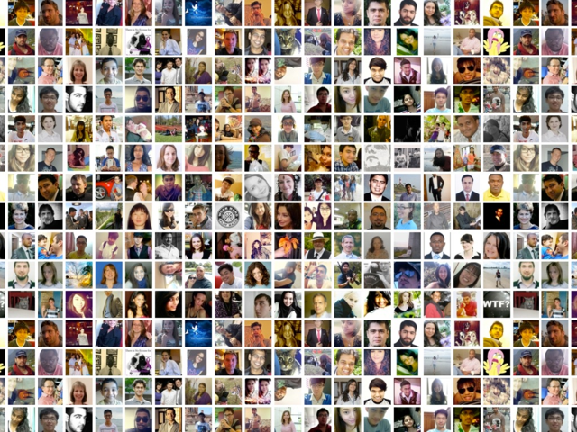
Massive Open Online Course
7500 Participants
150 Countries
Notes:
The course has exercise to remove the P-Word from the vocabulary of the participants, Brain Rewiring and aimed at developing Self Awareness, Self Management, Social Awareness and Relationship Management

Slide 8
Emotional Intelligence
Daniel Goleman
Self
Social
Regulation
Self Management
Emotional Self Control
Transparency
Adaptability
Achievement Orientation
Initiative
Optimism
Relationship Management
Developing Others
Inspirational Leadership
Influence
Change Catalyst
Conflict Management
Teamwork and Collaboration
Awareness
Self Awareness
Emotional Awareness
Accurate Self Assessment
Self Confidence
Social Awareness
Empathy
Organisational Awareness
Service Orientation

Slide 9
How to Develop Emotional Intelligence?
Brainology: How the brain works (Carol Dweck)
Brain-Body-Connection (Paul Ekman)
Self Management can be taught (Walter Mischel)
Gamification of the change of language
Online activities and submissions
  Brain Rewiring
  My Emotions Today
  Mission Partnerships
  Etc…
E-Certificates
E-Badges

Slide 11


Youth Transformation Programme

