Slide 1
INVOKING THINKING THROUGH LEARNING DESIGN
ASSOC. PROF. DR. WAN ZUHAINIS SAAD
Director
Academic Development Management Division
Department of Higher Education
Ministry of Education
Malaysia

Slide 2
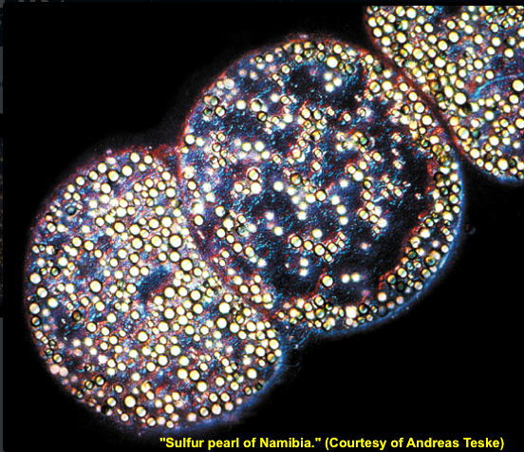
Thiomargarita namibiensis

Slide 3
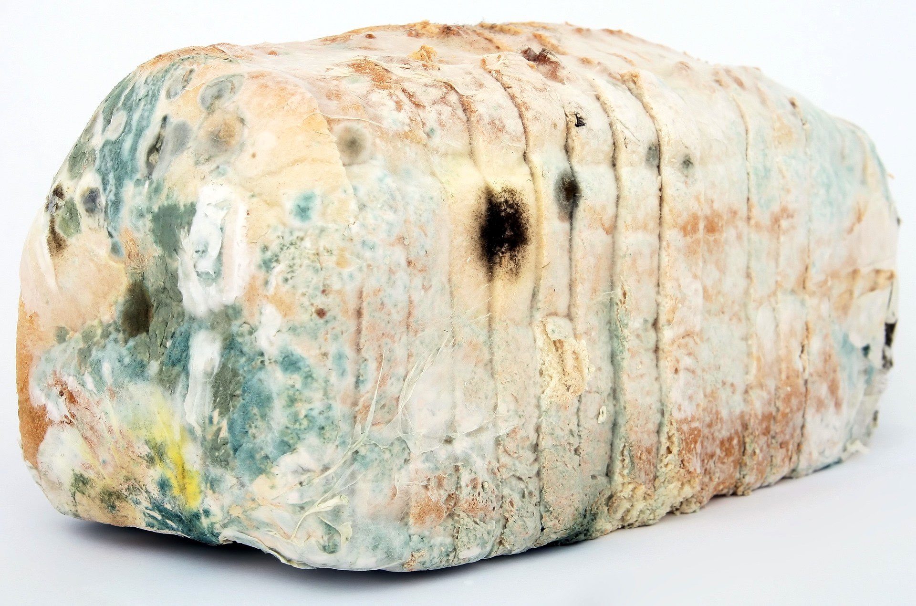

Slide 4
many type of Lactobacillus
Lactobacillus shirota
FOOD INDUSTRY

Slide 5
Clostridium botulinum
DISEASE
COSMECEUTICAL

Slide 6
Propionibacterium sharmenii
Lactococcus and Lactobacillus

Slide 7
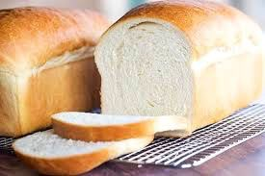
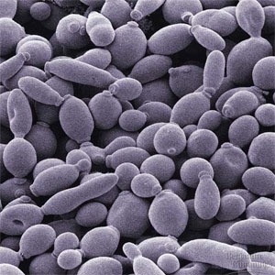
YEAST - FUNGUS

Slide 8
FOOD SPOILAGE

Slide 9
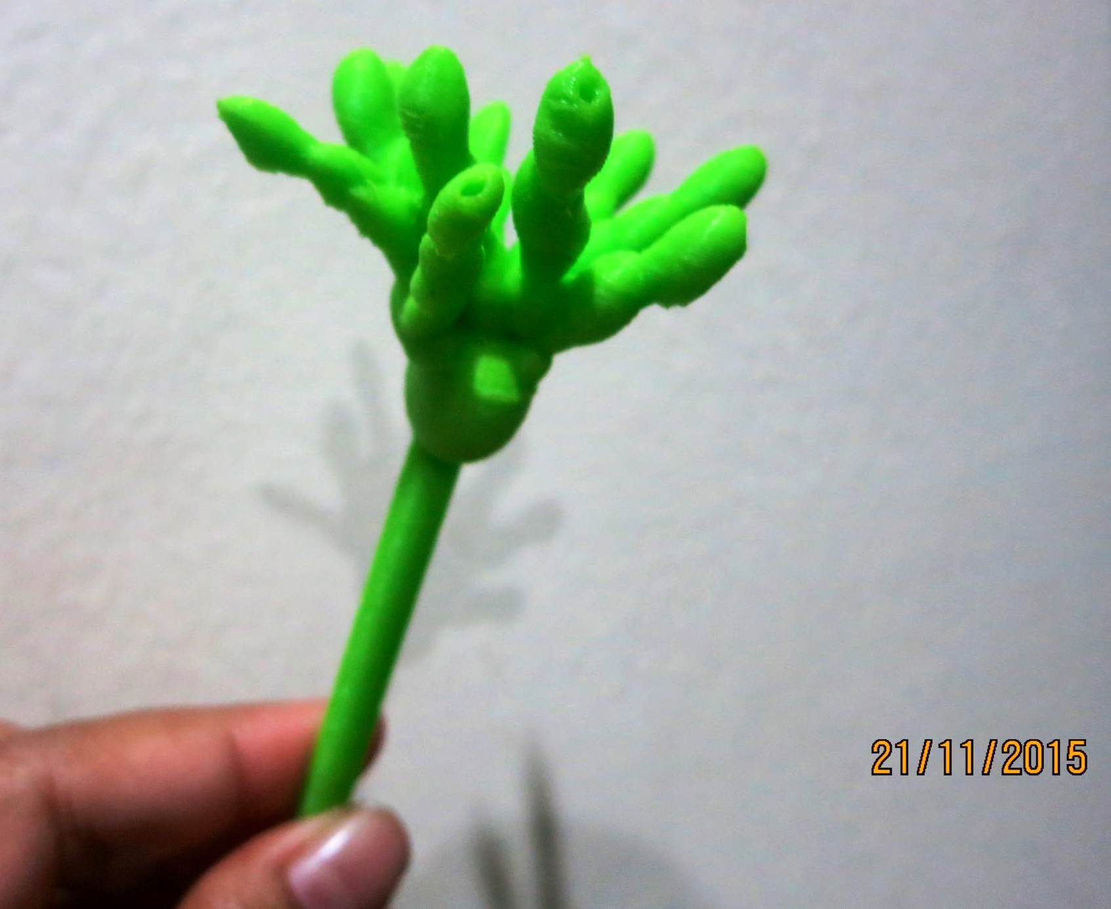

Slide 10
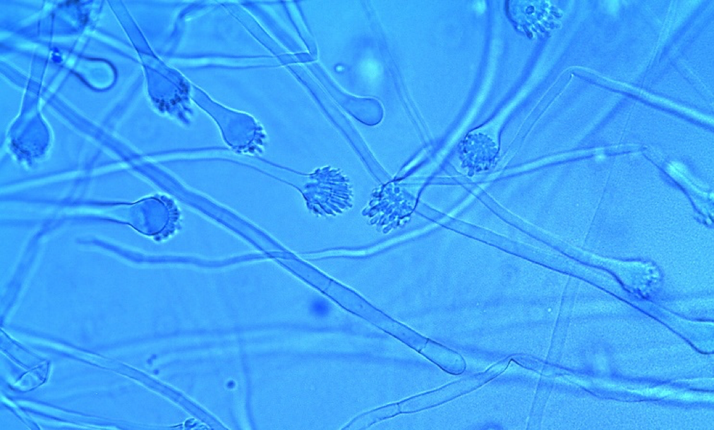
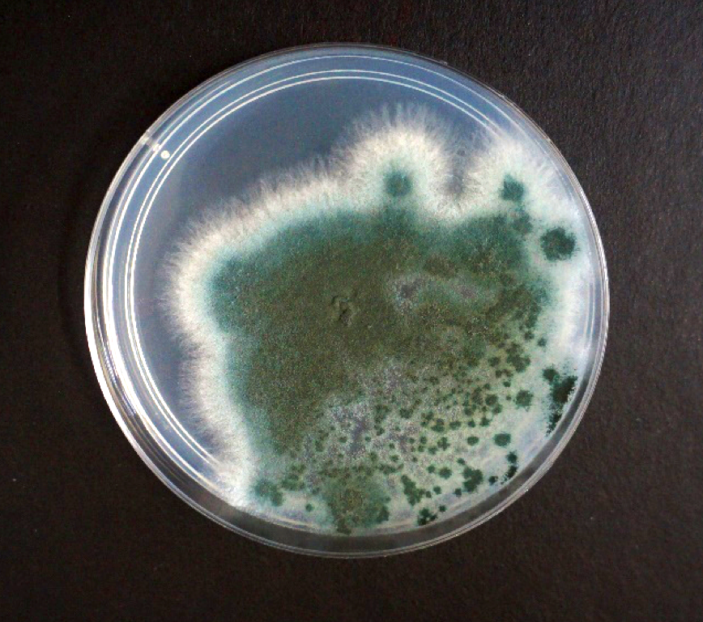
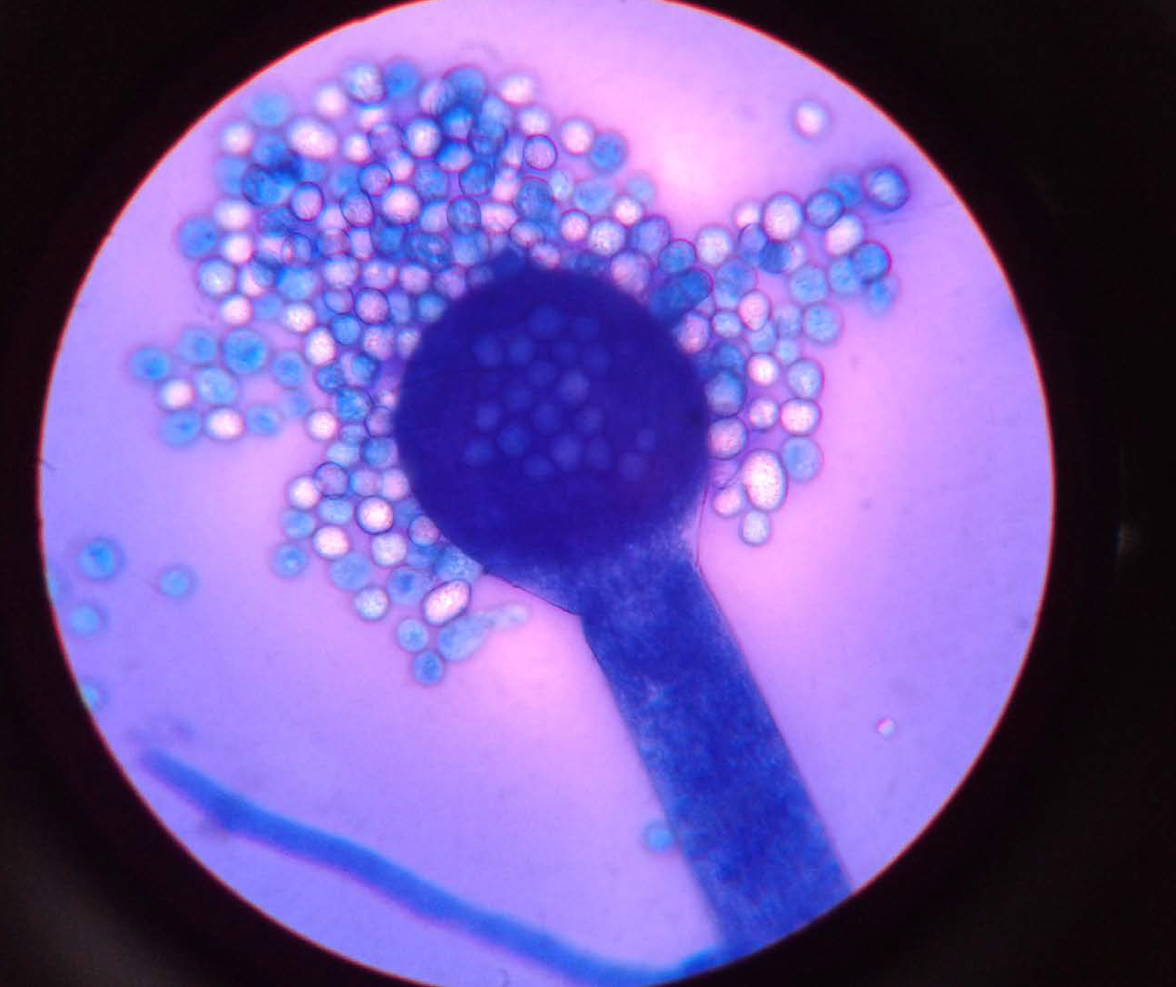
Aspergillus -fungus

Slide 11
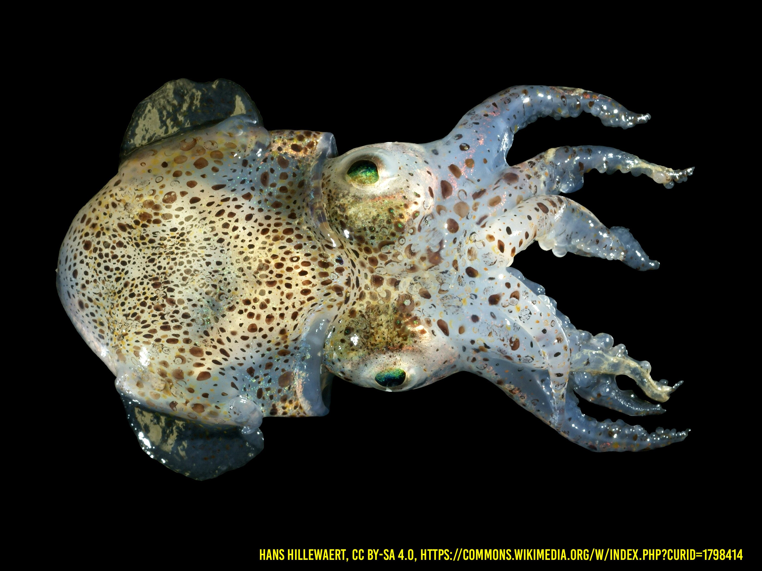
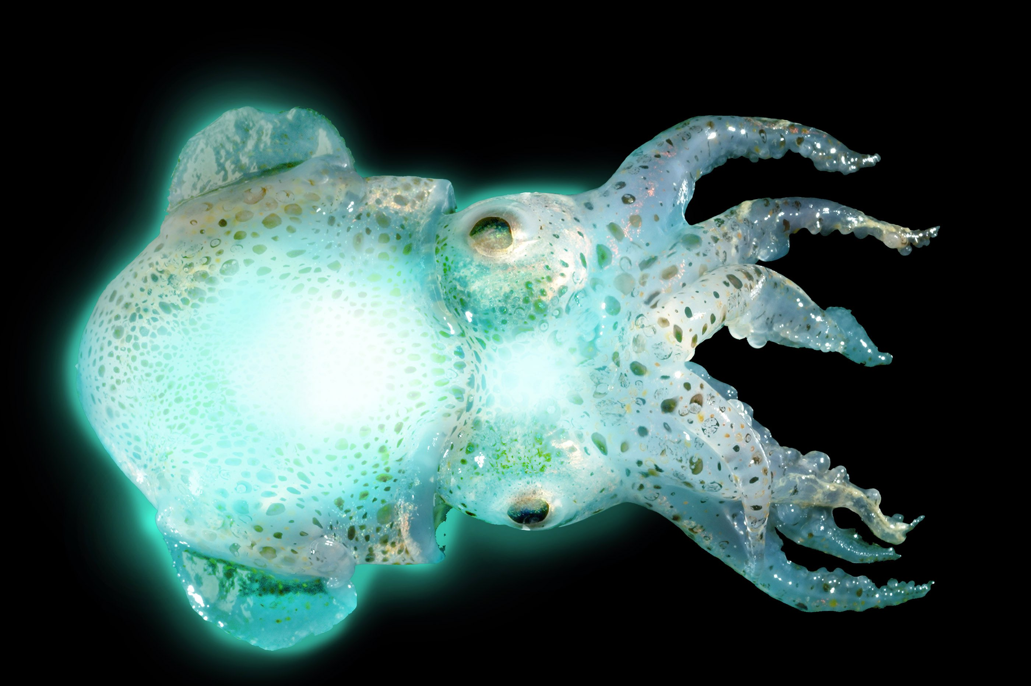
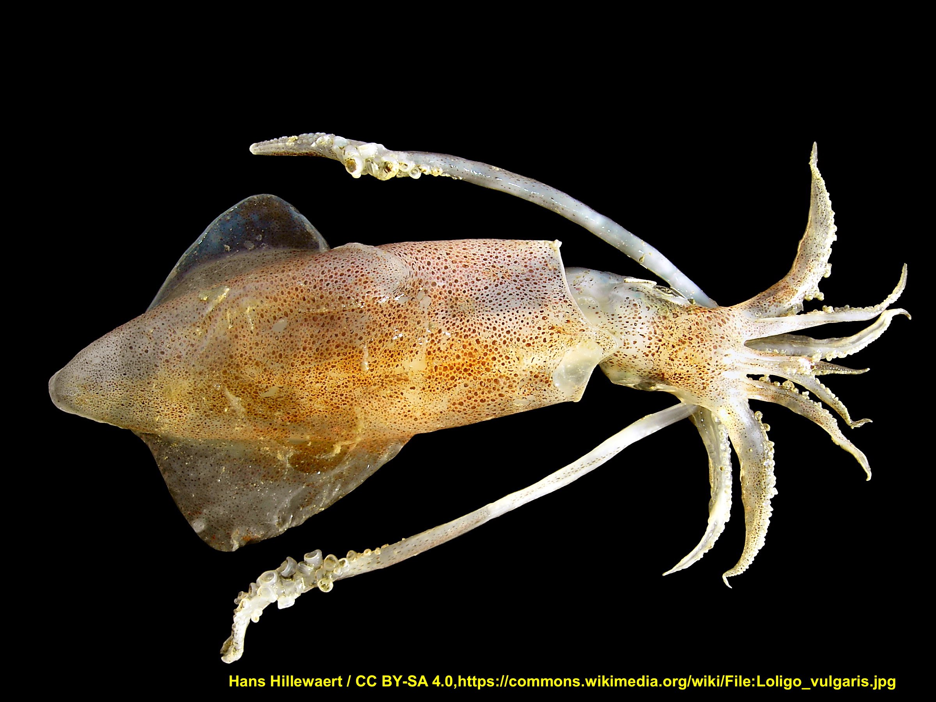
A
B

Slide 12
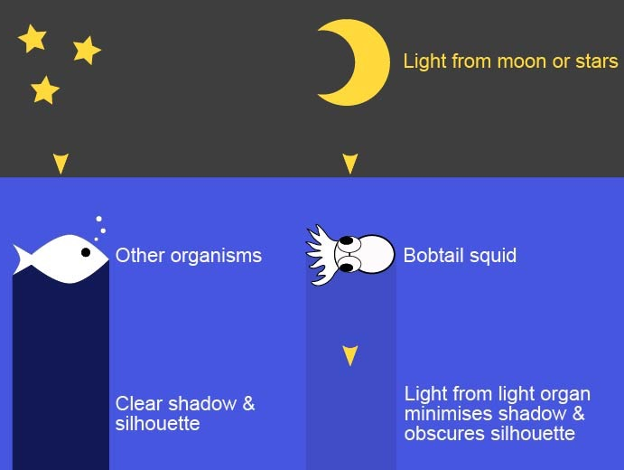

Slide 13
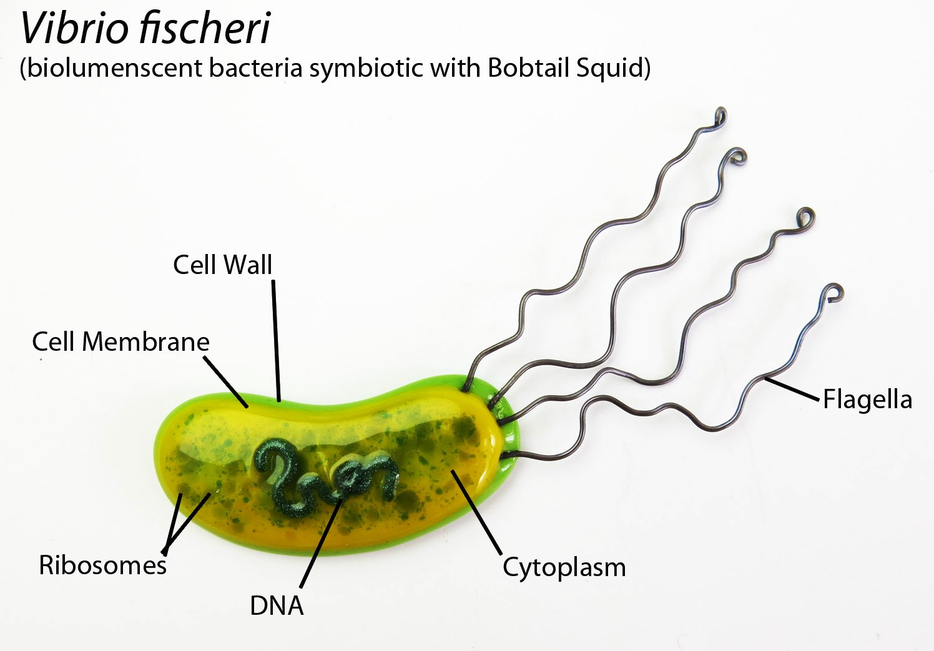
QUORUM SENSING

Slide 15
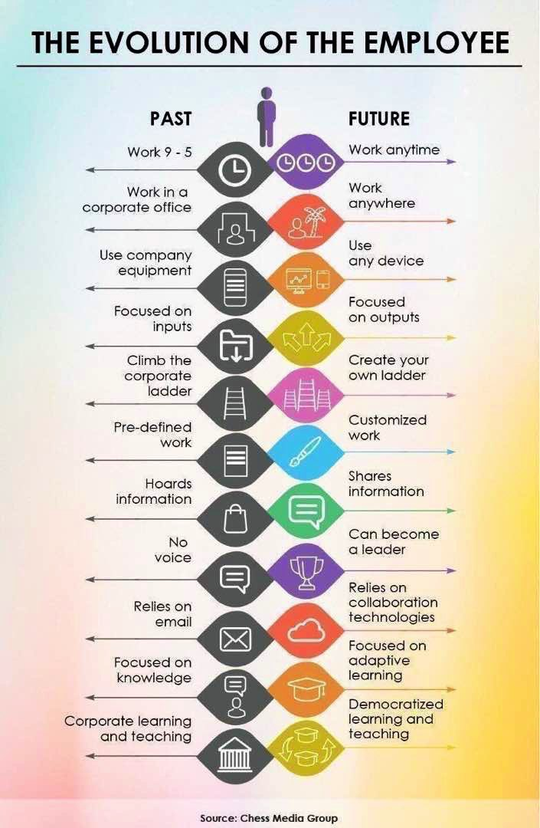

Slide 19
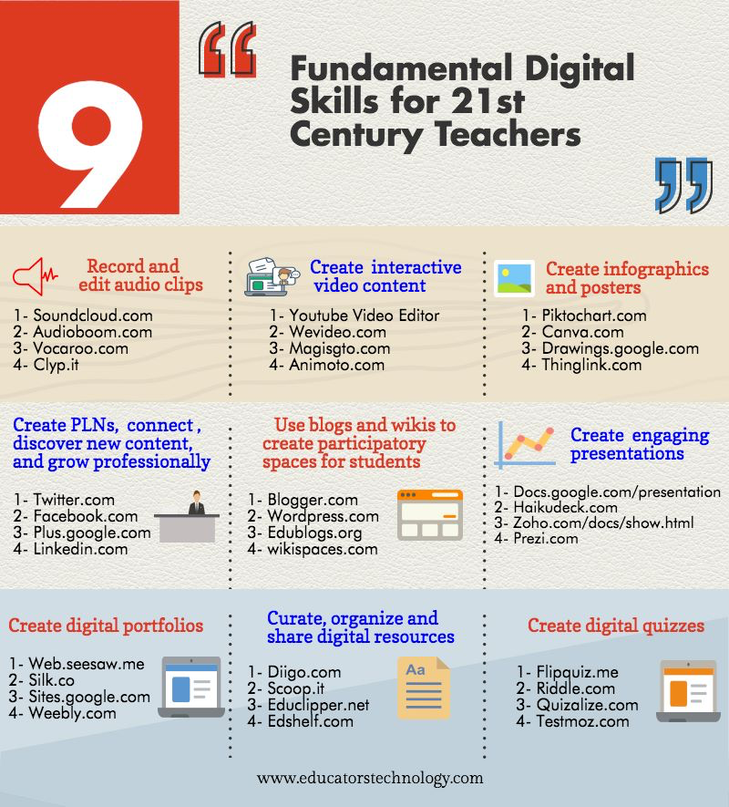

Slide 20
Go to www.menti.com and use the code 79 69 6

Slide 21
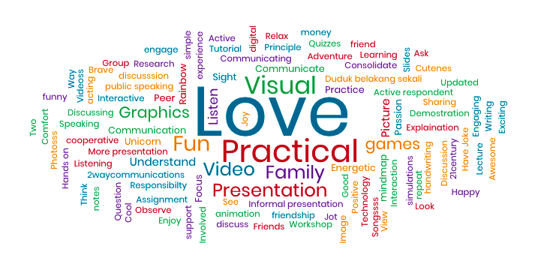
WZS@UPM

Slide 23
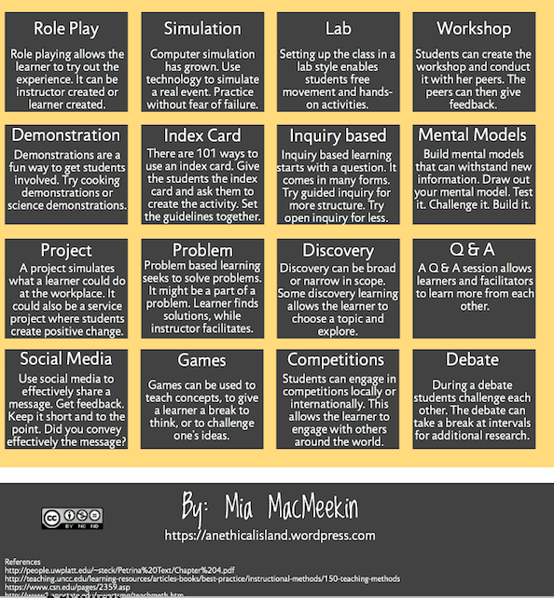

Slide 24
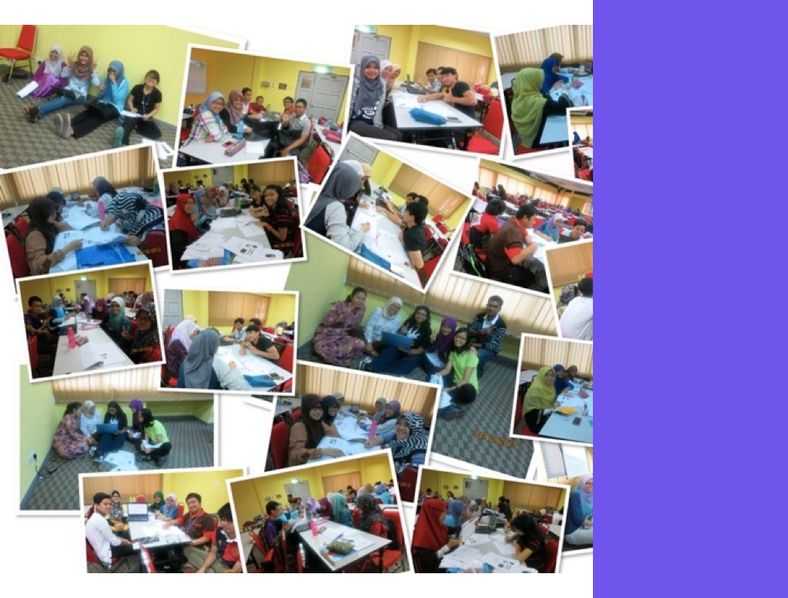
WZS@UPM

Slide 25
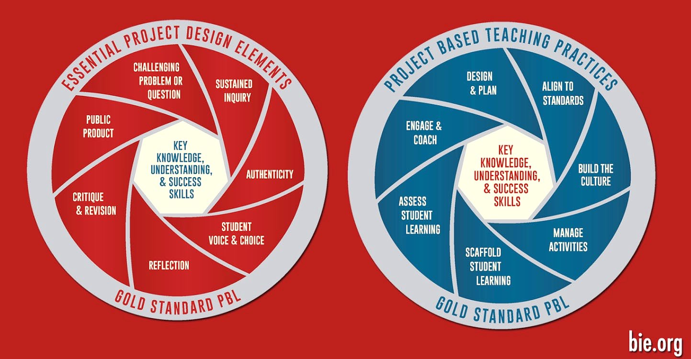
PROJECT BASED LEARNING

Slide 28
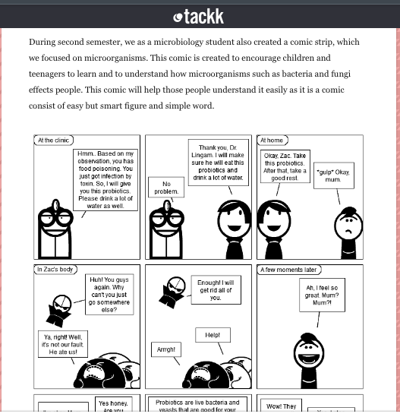
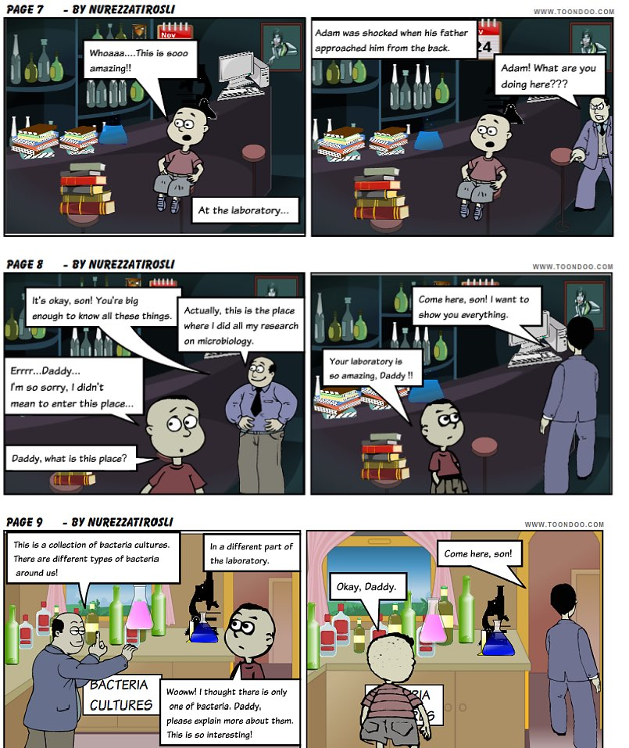
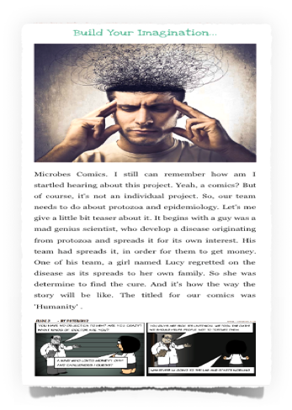
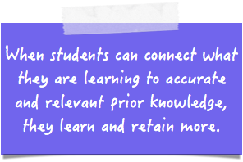
WZS@UPM

Slide 29
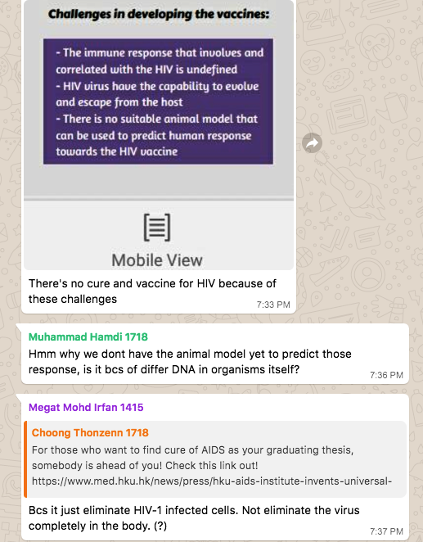
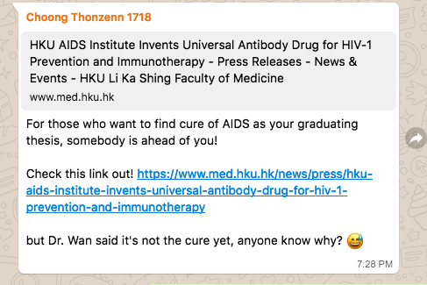

Slide 30
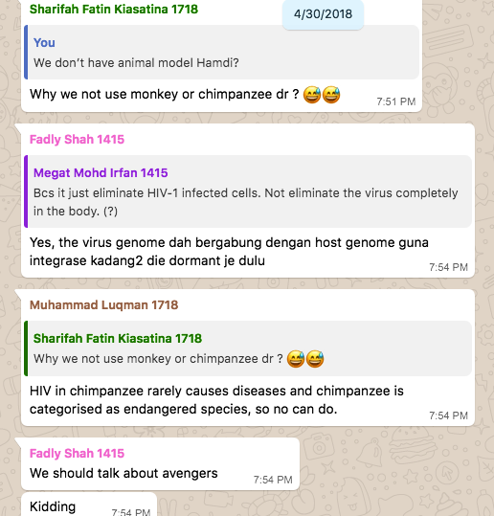

Slide 31
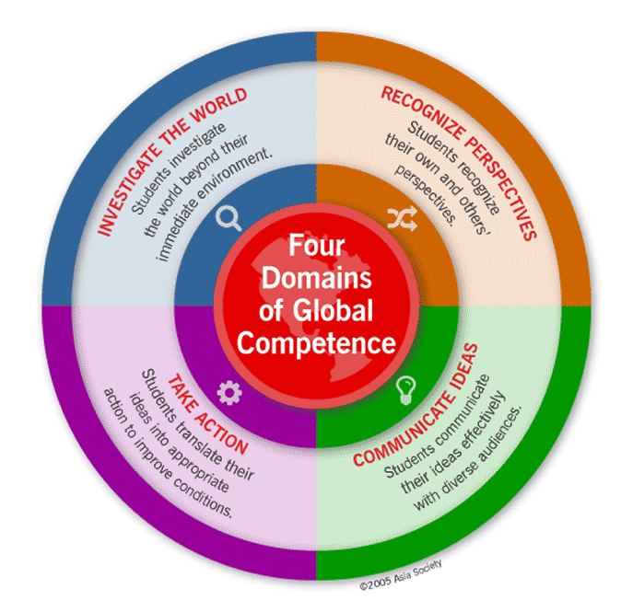
Communities do not rise spontaneously from the primordial soup of learning

Slide 34
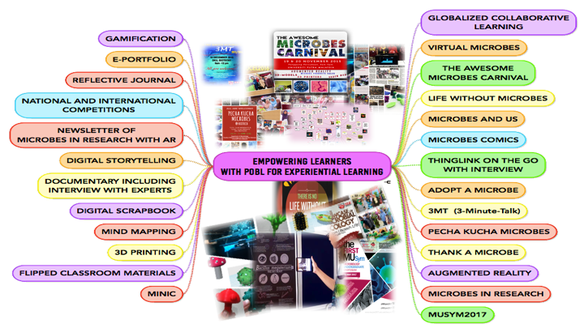
WZS@UPM

Slide 35
“You Have to Absorb Yourself in It”
that our work is not merely to share information but to
share in the intellectual and spiritual growth of our students.

Slide 37
REFLECTIONS
‘In Their Own Words.’
Learners should make meaning of their own experiences

Slide 38
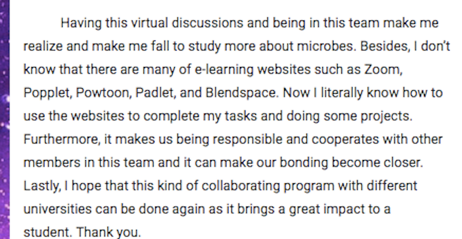
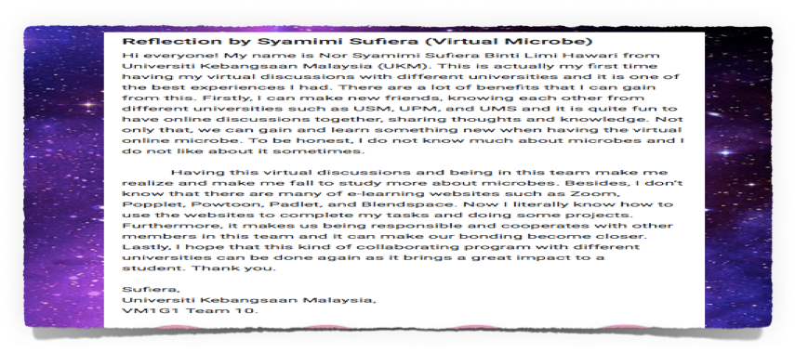
WZS@UPM

Slide 39
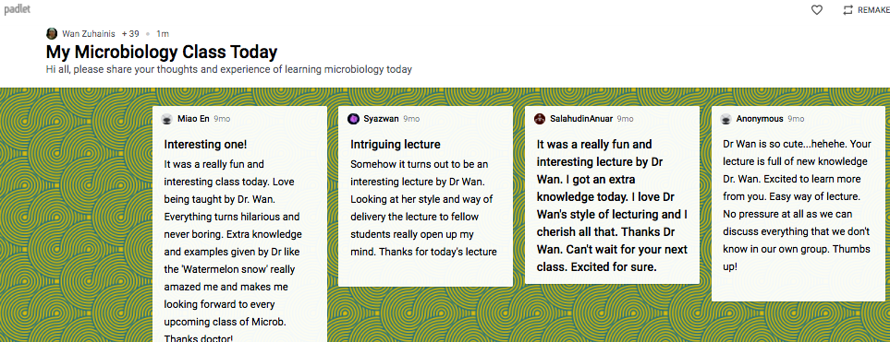
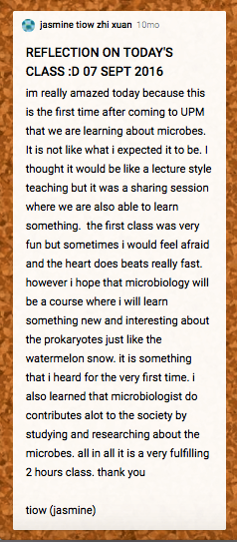
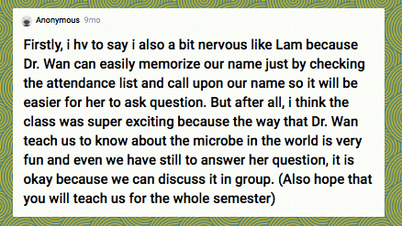

Slide 40
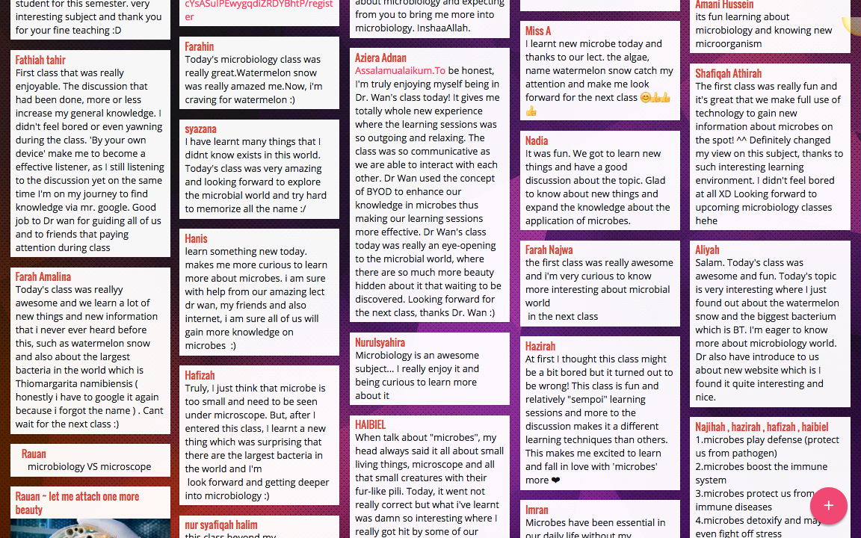

Slide 41
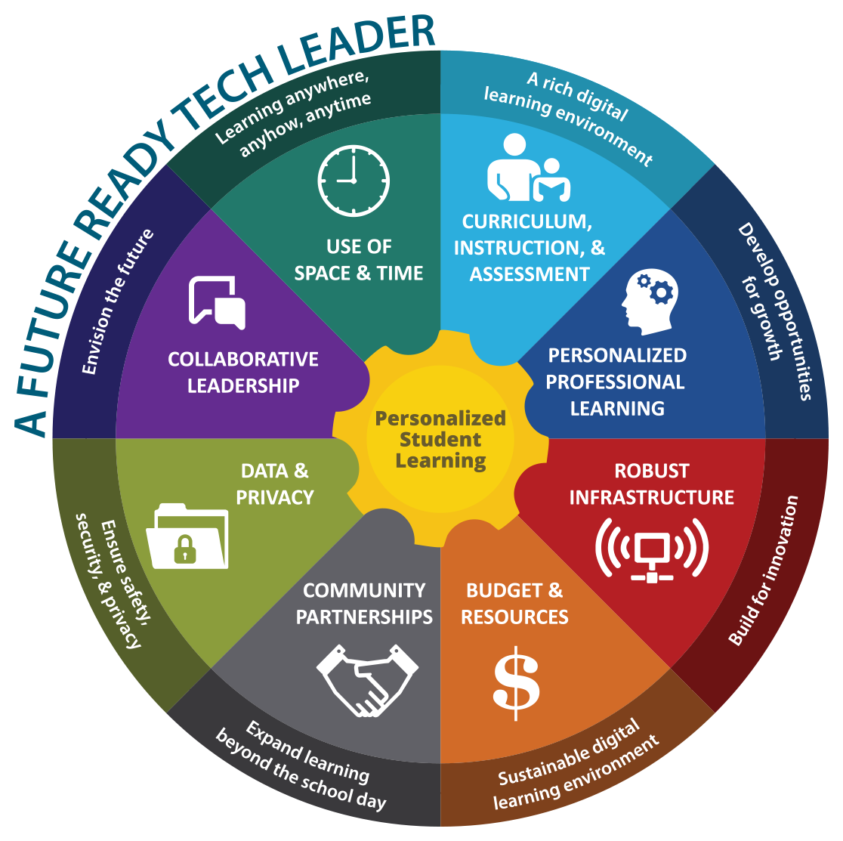
www.FutureReady.org/TechLeaders

Slide 43
Spark curiosity
Explore learning
Fuel imagination

