Slide 1
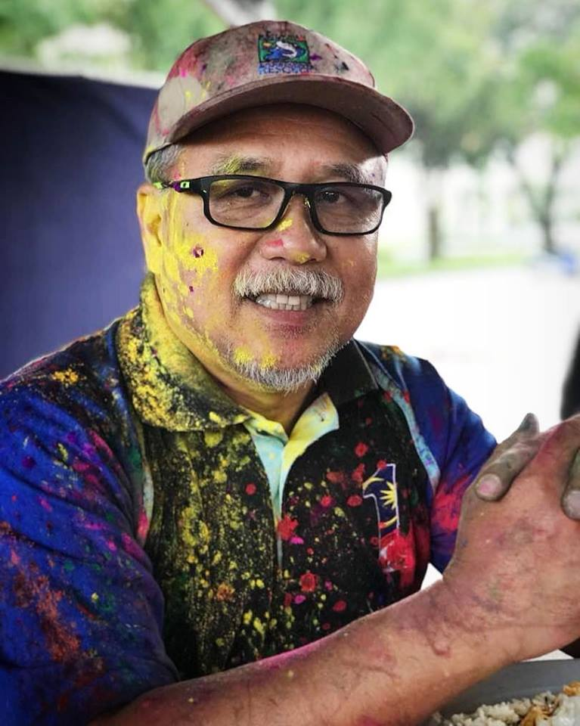
USM TEACHING & LEARNING SYMPOSIUM
HEBATising Future Talent #USM Style
HEBAT@USM –
Our Journey
& My Experience
PROFESOR DATO’ DR. ADNAN BIN HUSSEIN
TIMBALAN NAIB CANSELOR
HAL EHWAL PEMBANGUNAN PELAJAR & ALUMNI

Slide 2
THE JOURNEY
Since early 1990s – 2014 | Holistic Student Development Policy
Apex Strategic Planning
Langkawi Workshop
2015 - 2020 | H.E.B.A.T
10 SHIFTS - Malaysia Education Blueprint
(Higher Education)

Slide 3
THE BLUEPRINT

Slide 4
Description of HEBAT
HOLISTIC
ENTREPRENEURIAL
BALANCED
ARTICULATE
THINKING
Holistic graduates would have relevant disciplinary knowledge and skills (ilmu), ethics and morality (akhlak), along with the appropriate mindsets, behaviors, cultural and civilizational literacy (beradab)
Forging new opportunities for themselves (graduates) and others. It is important to
move from a world of job seekers to a world of job creators.
The development of moral values, a strong national
identity (jati diri kebangsaan), cultural and civilizational
literacy (beradab), self-awareness, and interpersonal
skills
Has mastery of own disciplines, is able to harness, connect and apply knowledge learnt, and has an appreciation of culture, arts, and
Science, Technology, Engineering and Mathematics (STEM)
Appreciates diverse views, is able to think critically and be innovative, has problem-solving initiative, and an entrepreneurial mindset.

Slide 5
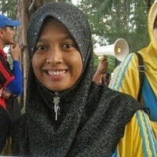
HEBAT GRADUATES
Hebat Hisham Md Yusoff
SM Sains Gunaan (Sains Fizik)
2007
Hebat Fatimah
Sm Sains Kemasyarakatan
(Kerja Sosial)
2005

Slide 6
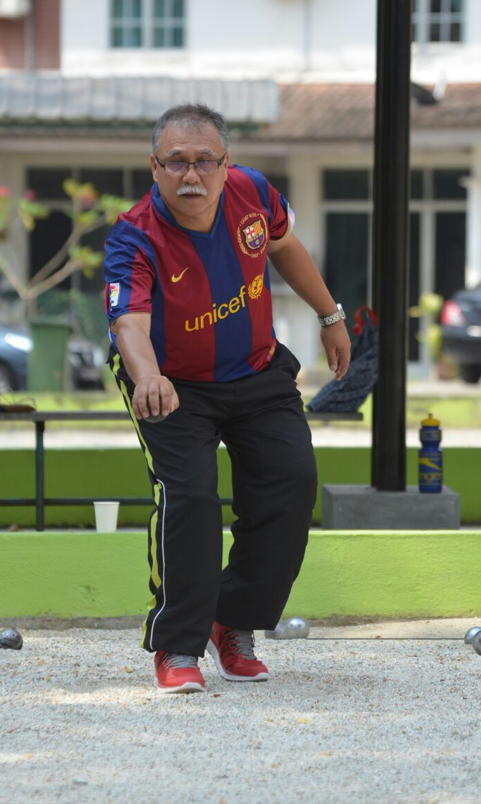
OUR GOAL, OUR ASPIRATION
To nurture and groom H.E.B.A.T graduates through innovative learning experiences, coupled with well-designed programmes and activities, and effective support system.
H.E.B.A.T graduates by design

Slide 7
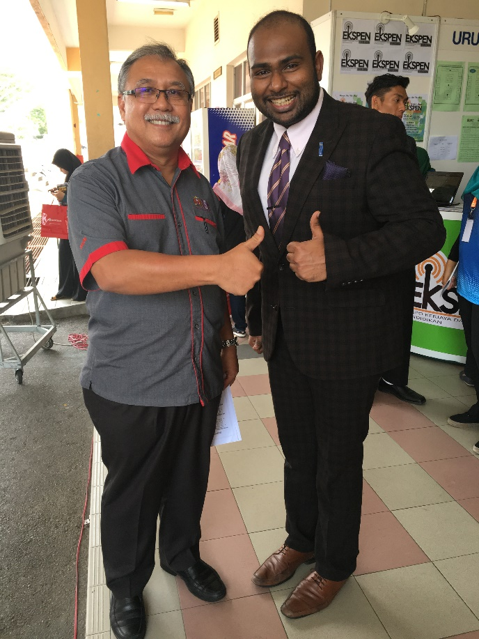
HEBAT GRADUATES
KISHVA AMBIGAPATHY
SM Kejuruteraan (Kej Elektronik)
2013
Chairperson,
Commonwealth Youth Council

Slide 8
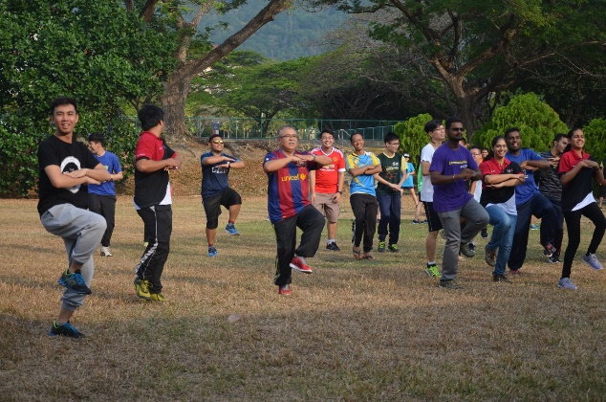
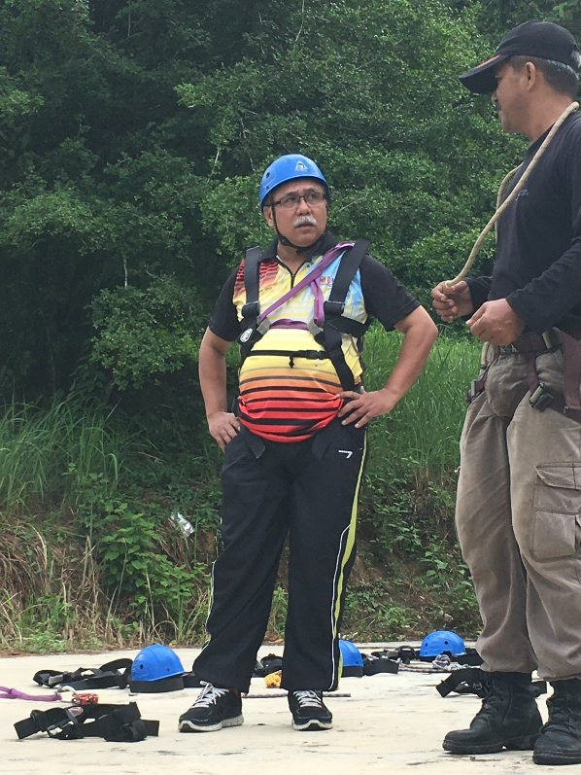
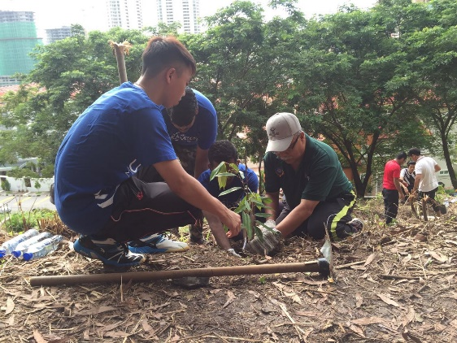
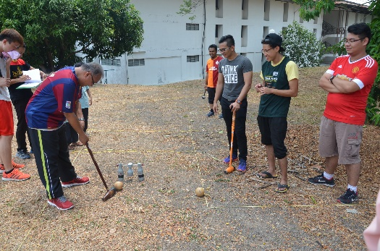
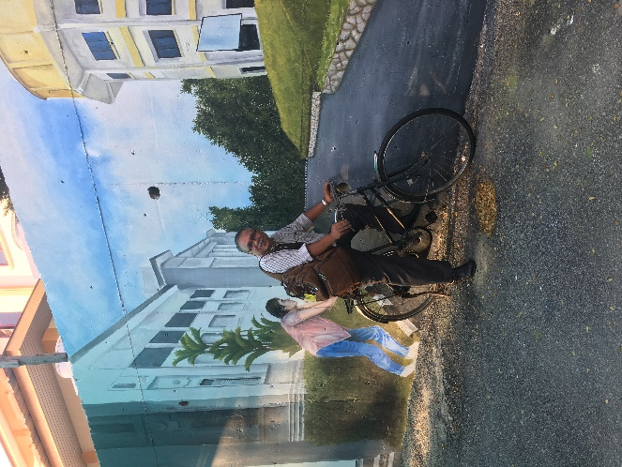
MY EXPERIENCE
Be among them Be one of them

Slide 9
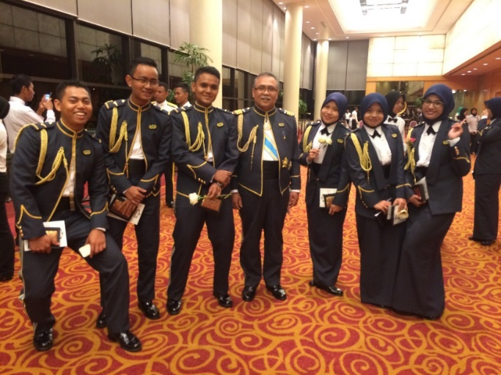
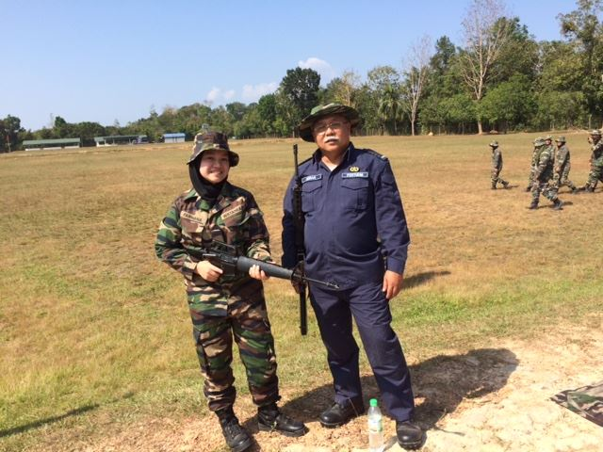
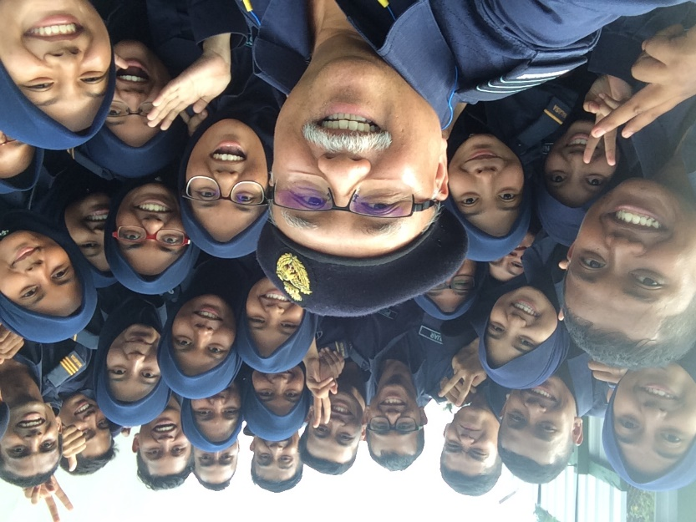
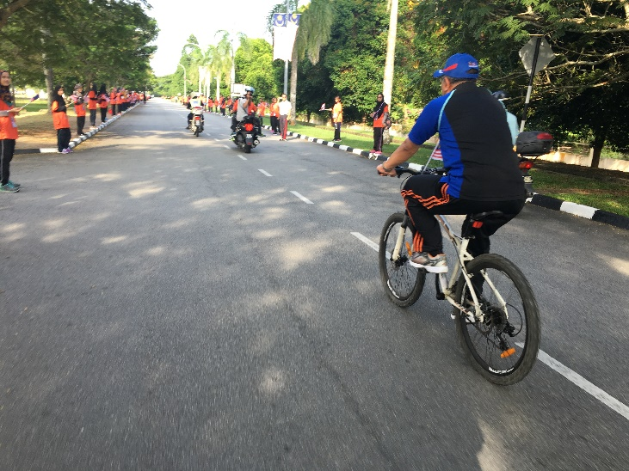
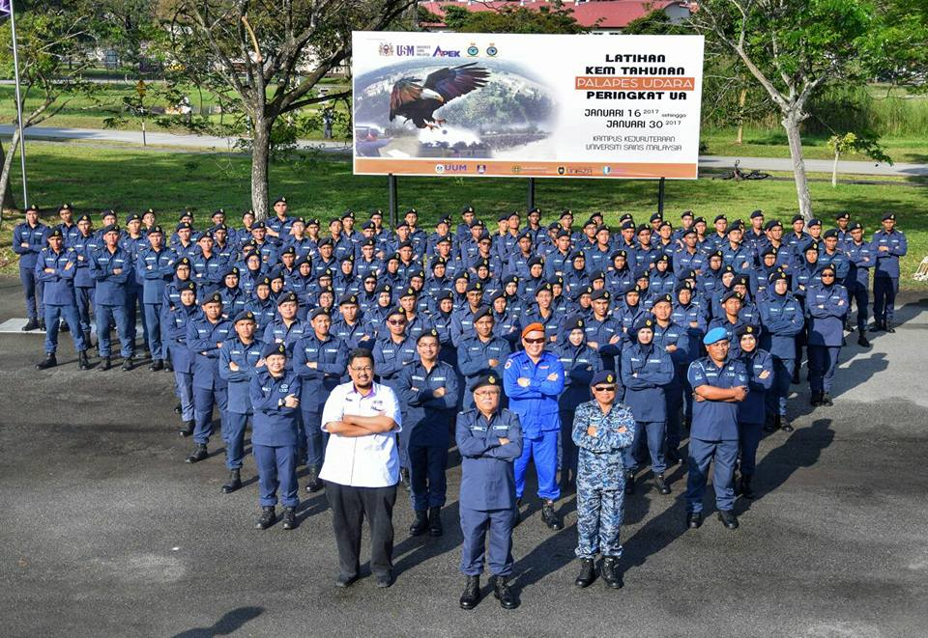
MY EXPERIENCE
Be Among them Be one of them

Slide 10
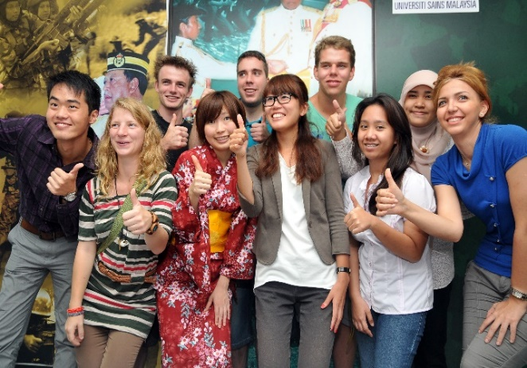
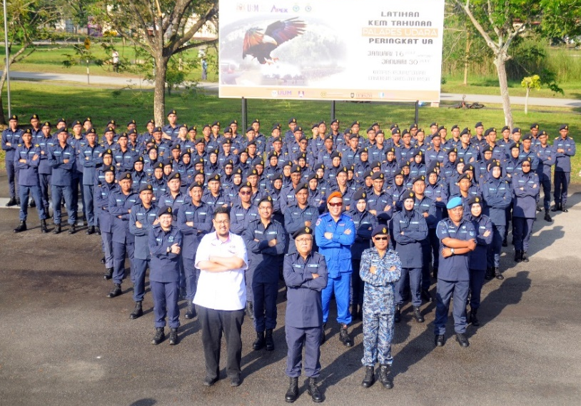
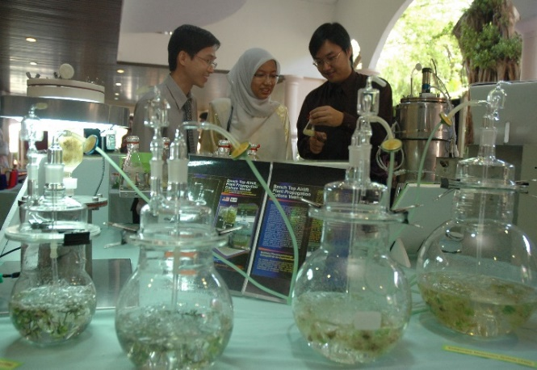
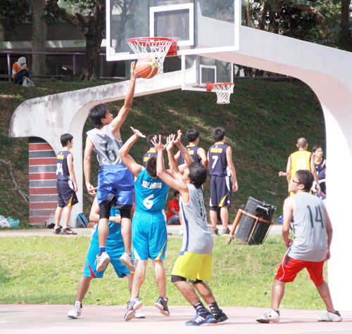
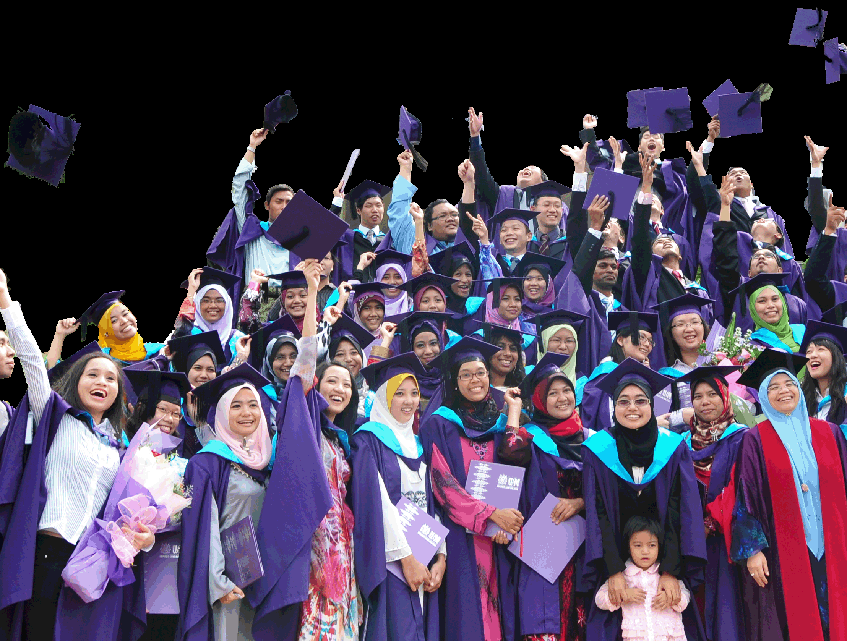
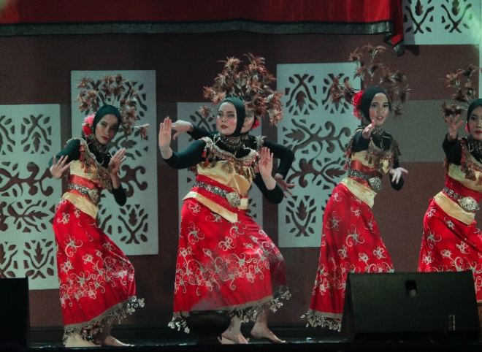
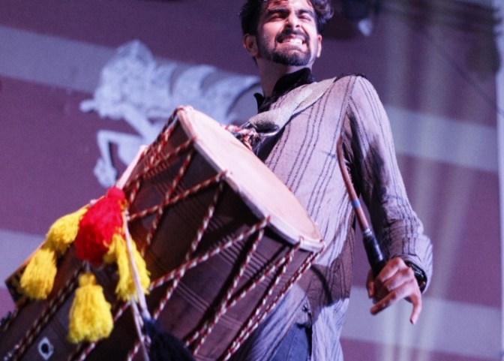
H.E.B.A.T STUDENTS
Kami Memimpin | We Lead
www.usm.my

Slide 11
