Slide 1

Notes:
Nine years ago, I was in the US for my Masters of Science in Public Health at Johns Hopkins.
During that time, I was living with my good friend, who was doing a PhD in Biostatistics and was an avid beekeeper.

Slide 2
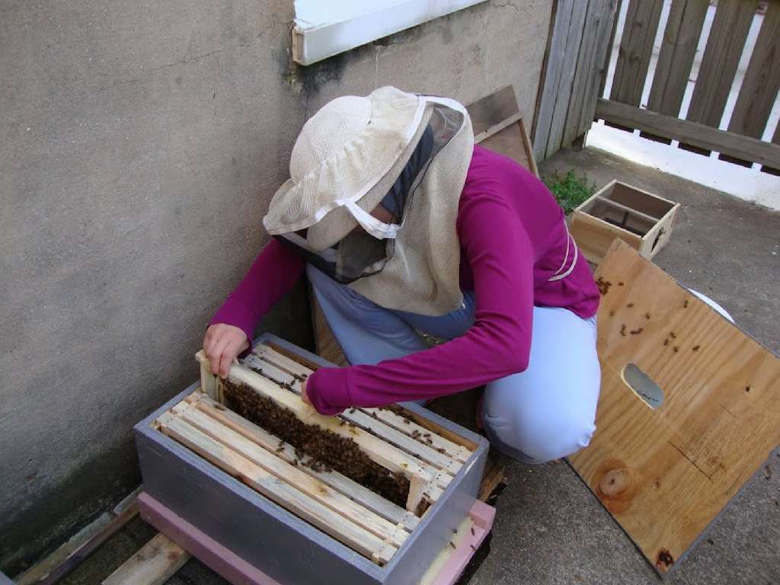
Notes:
We lived in a groundfloor apartment in Baltimore, had a little yard where she kept her hives.

Slide 3
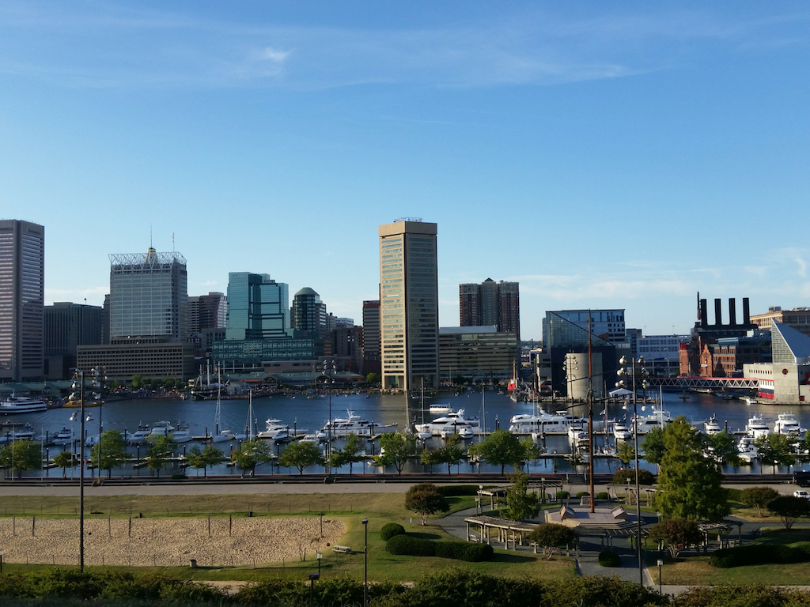
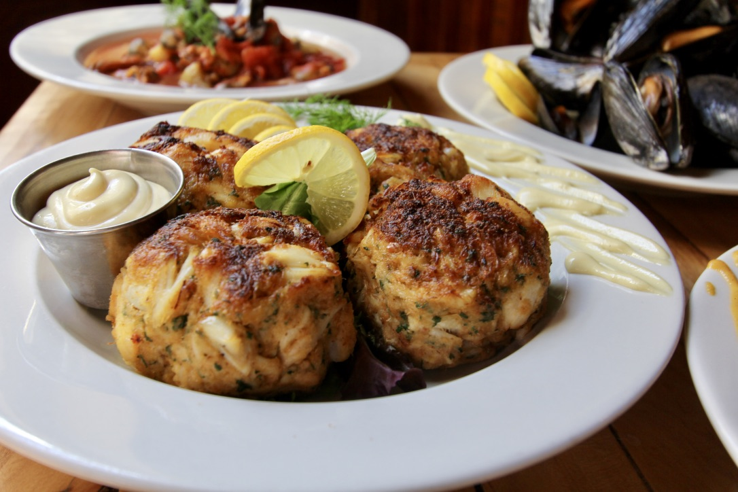
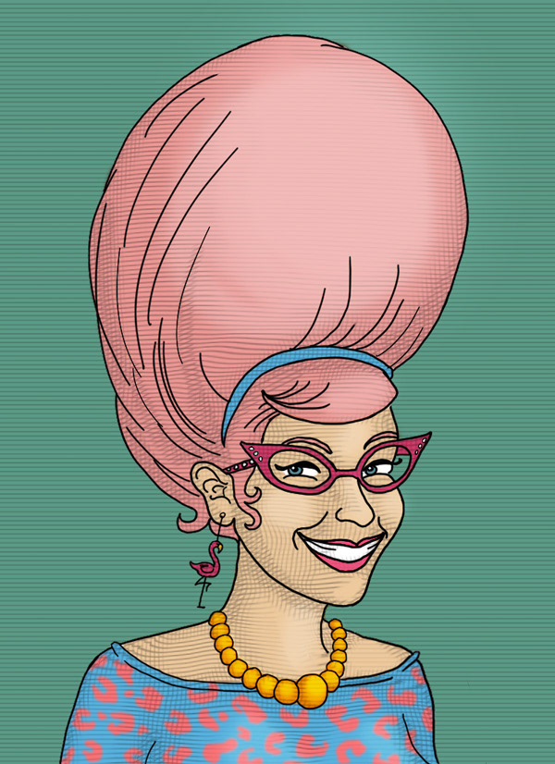
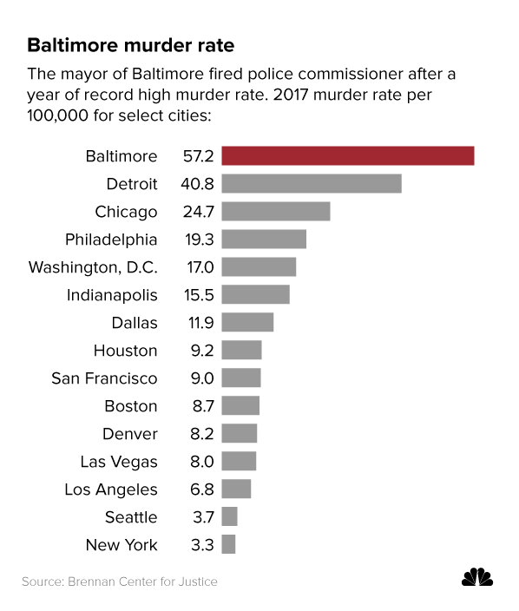
Notes:
The city of Baltimore is famous for a few things: its homicide rate, crab cakes and the hon hair.
It’s not famous for having a lot of snow.

Slide 4
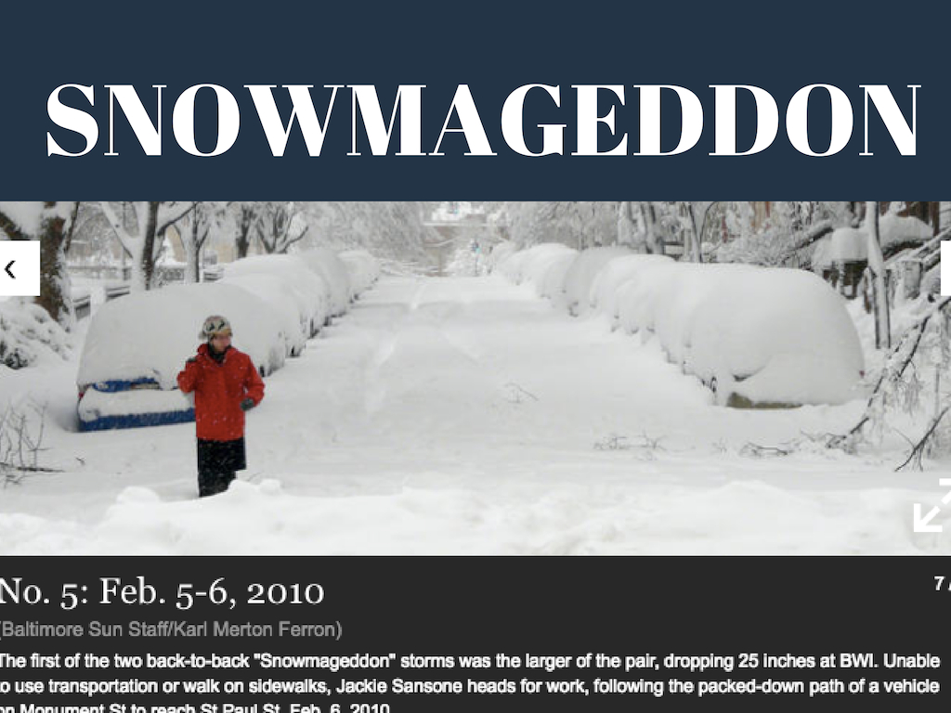
Notes:
But in the short time I was there, we had what the city called a snowmageddon.
In fact, we had three that year—and all three ranked in the top 10 biggest snowfalls in Baltimore history.

Slide 5
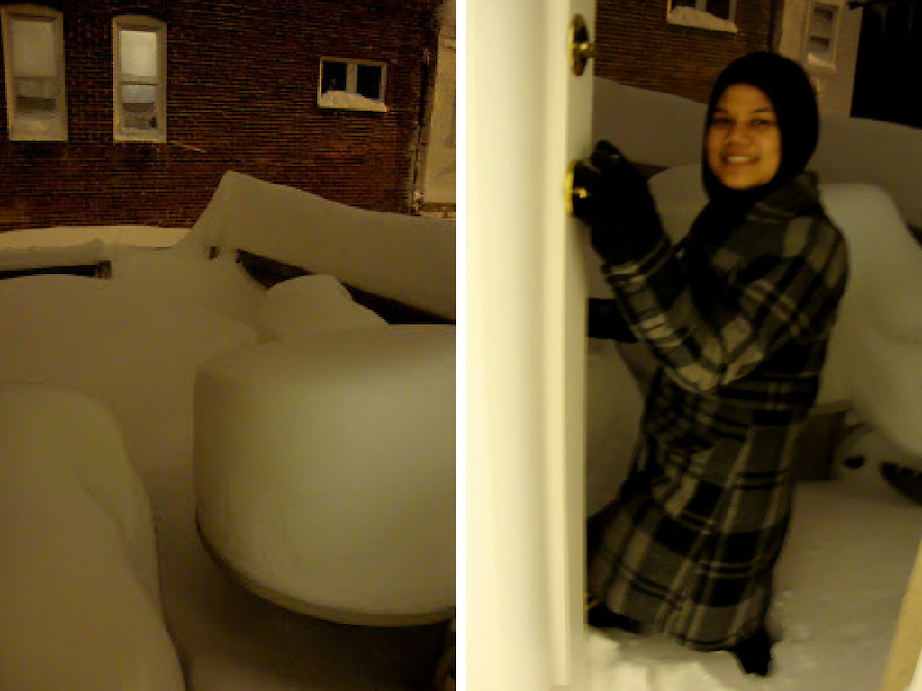
Notes:
For the worst snowmageddon, a two-day emergency holiday was declared because the city was completely unprepared and everyone was snowed in.
In the post-snowmageddon morning, our yard had snow up to my thighs.

Slide 6
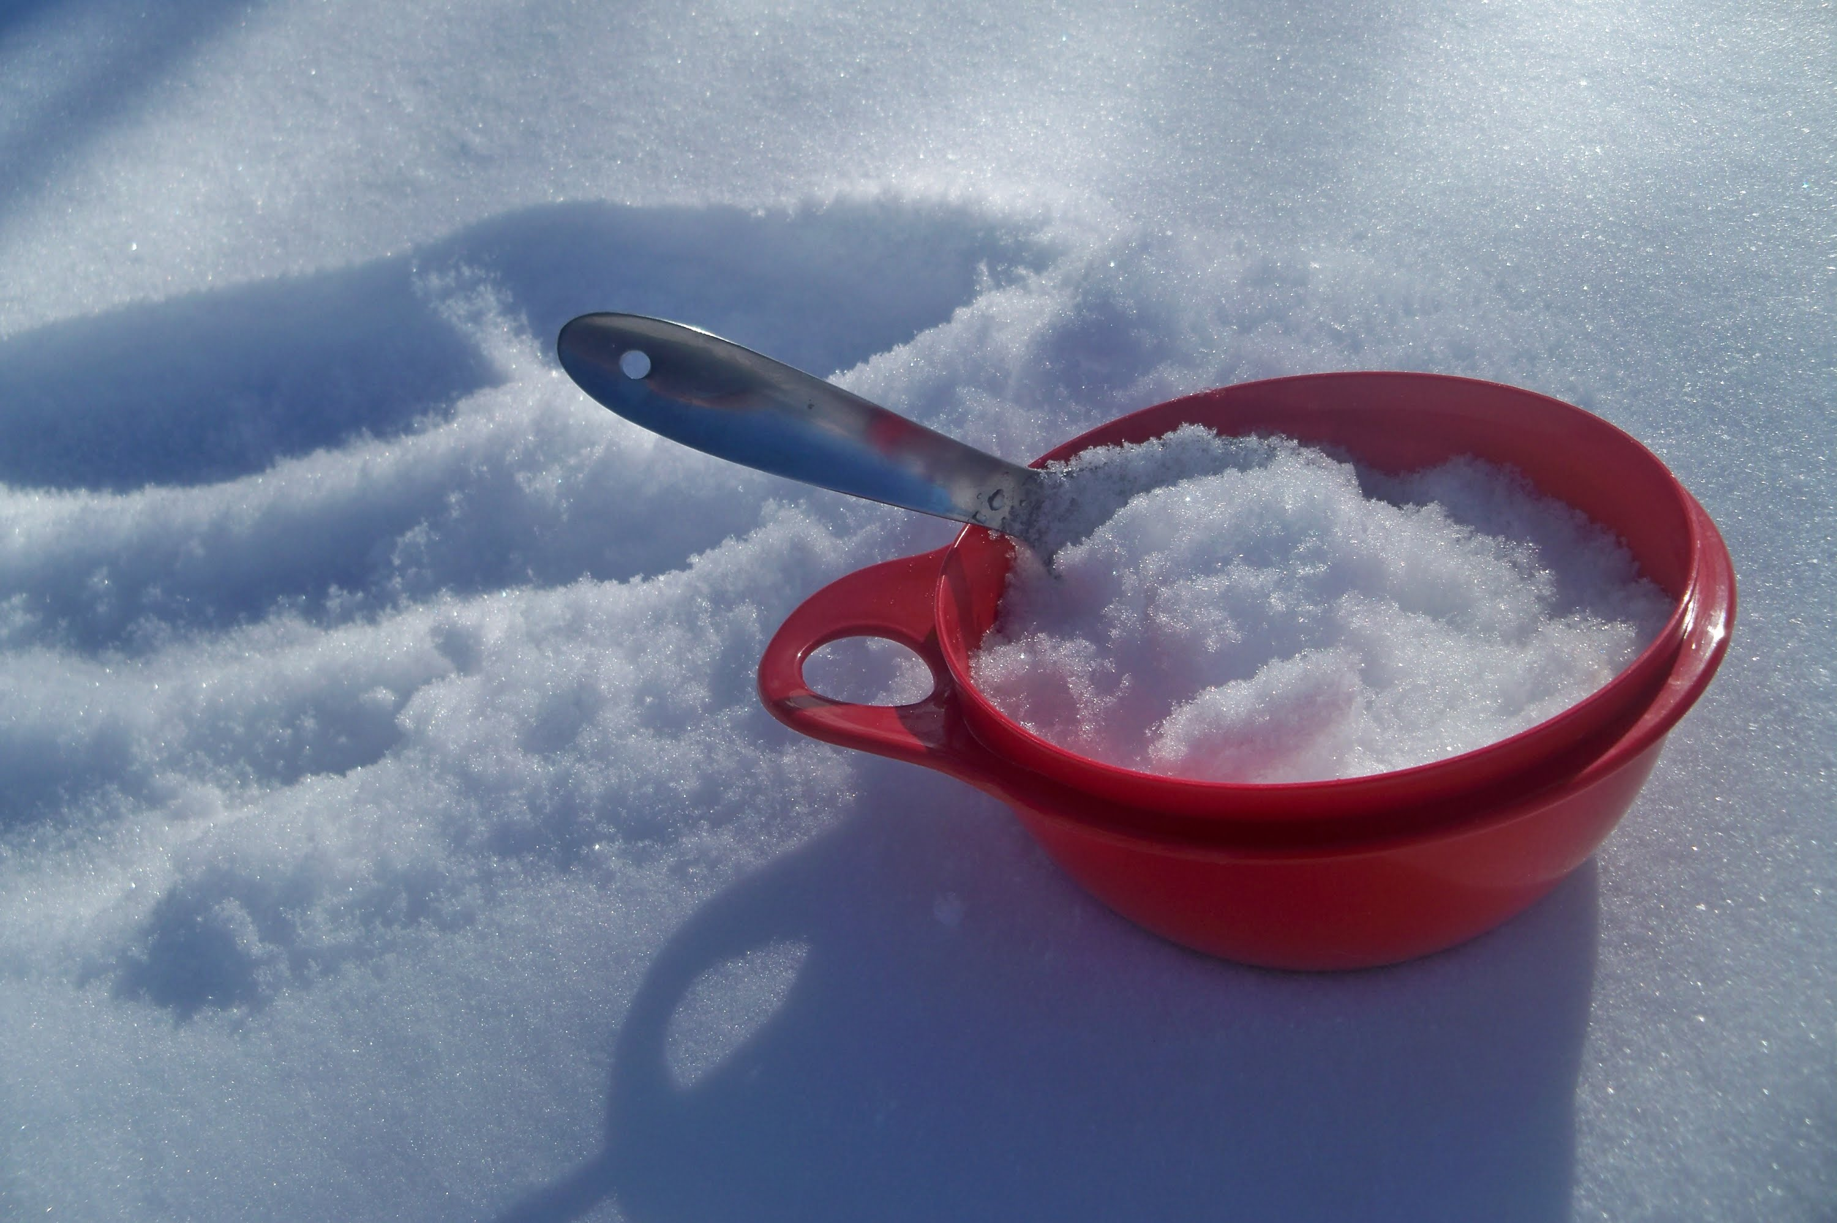
Notes:
So while we were enjoying some fresh ice kacang for breakfast, we wondered what do we do with all this time and all this snow?

Slide 7
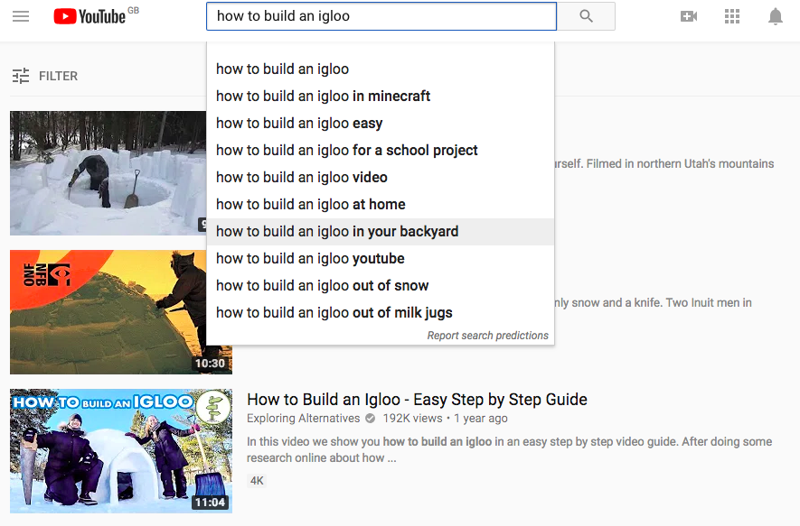
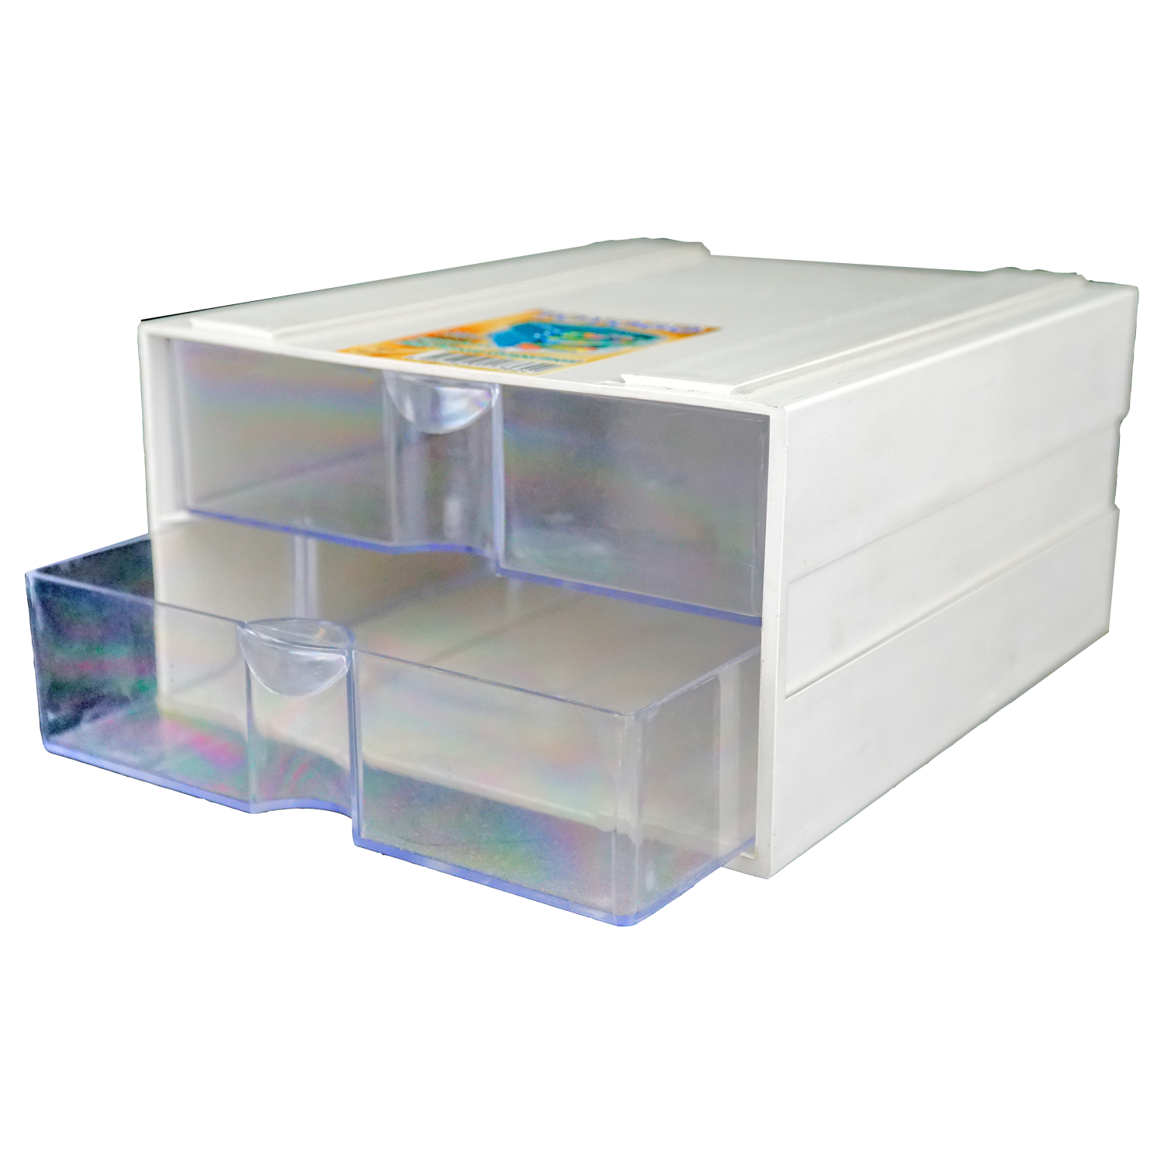
Notes:
Why not turn it into an igloo? So we YouTubed a protocol, located some brick-molding containers, which happened to be my Toyogo drawers and we called in some like-minded friends.

Slide 8
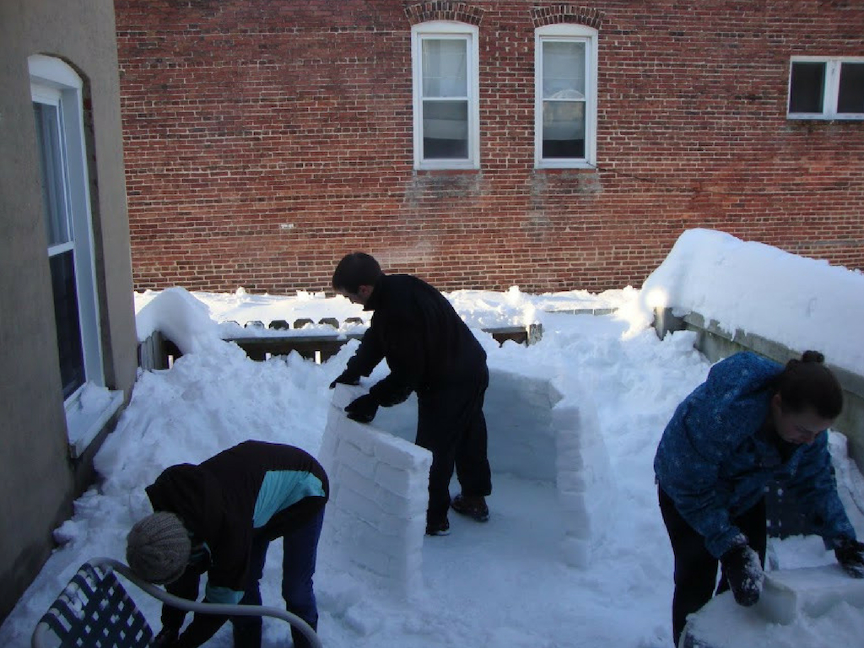
Notes:
After two-days of in the freezing cold. Working day

Slide 9
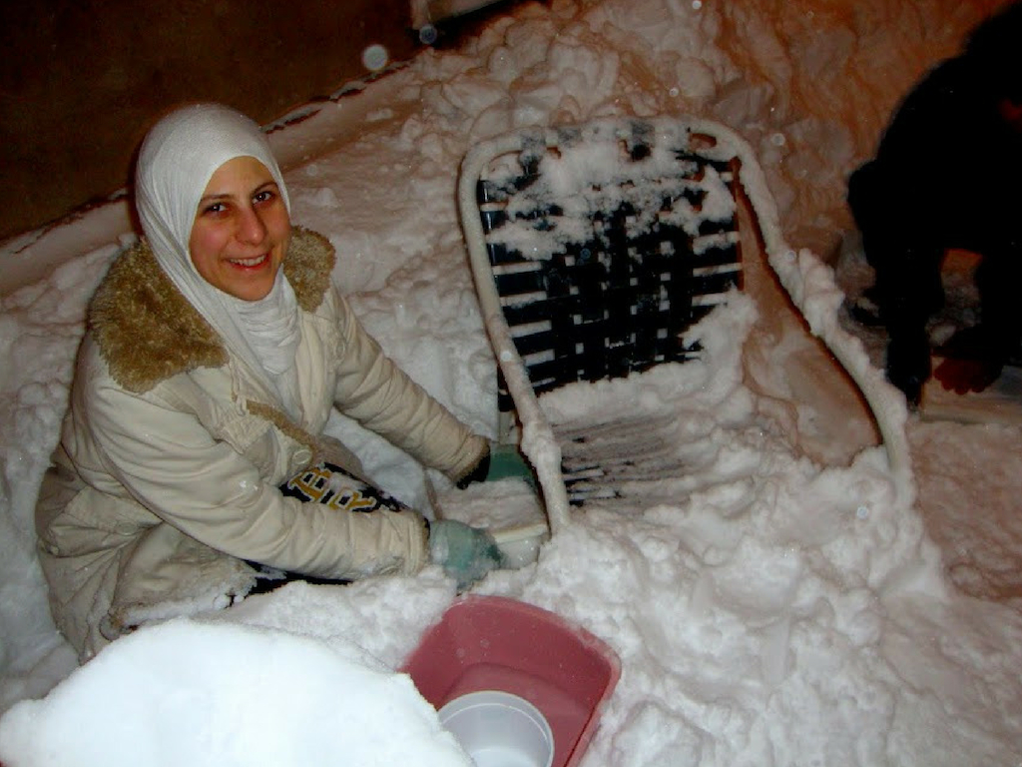
Notes:
and night

Slide 10
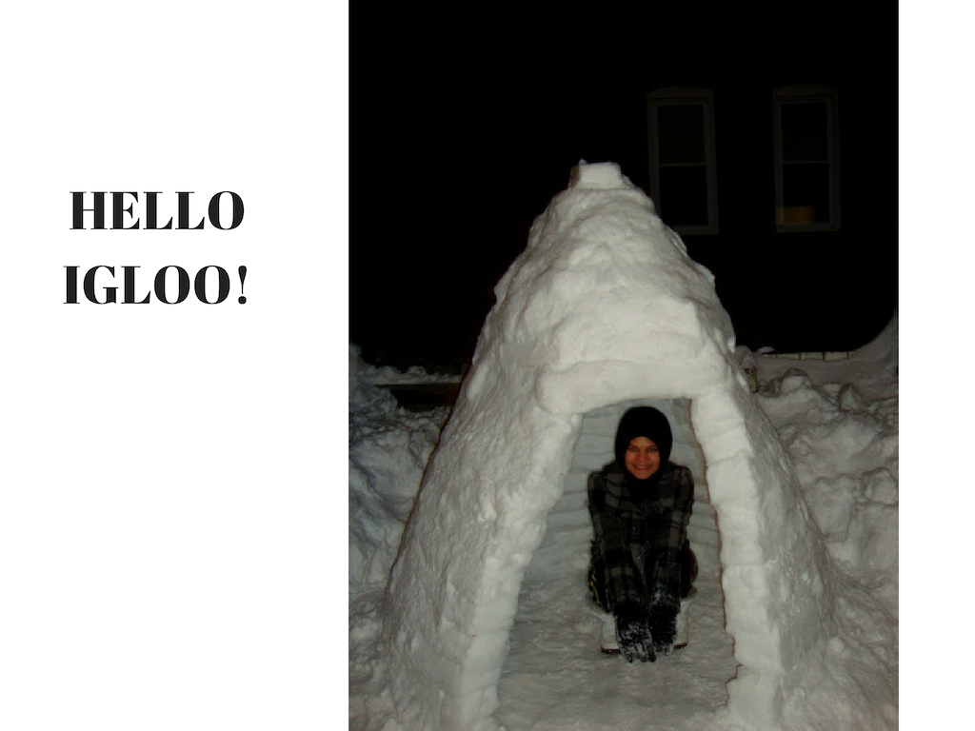
Notes:
—we built something that resembled an igloo.
There are few things I’ve done in my life that I think were great, that wonky igloo was one of them.

Slide 11
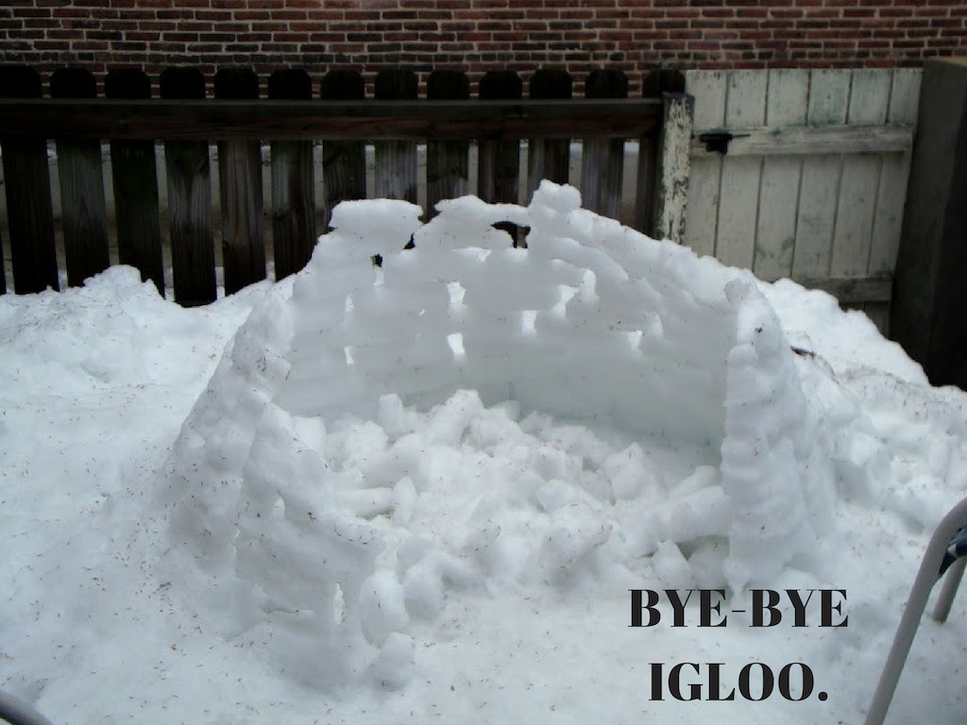
Notes:
You might be wondering—how can something that no one remembers except for the people involved, something that eventually melted, and something that gave no lasting recognition could ever be considered great? Well.
We worked for two days in the freezing cold.
No prior experience, no clue if it would work and nobody forced us to do it.
All we had was some snow. Some time. And a goal. And with some effort, we achieved it.
This achievement never graced my resume but it gave me satisfaction that I can do things I set to achieve.

Slide 12
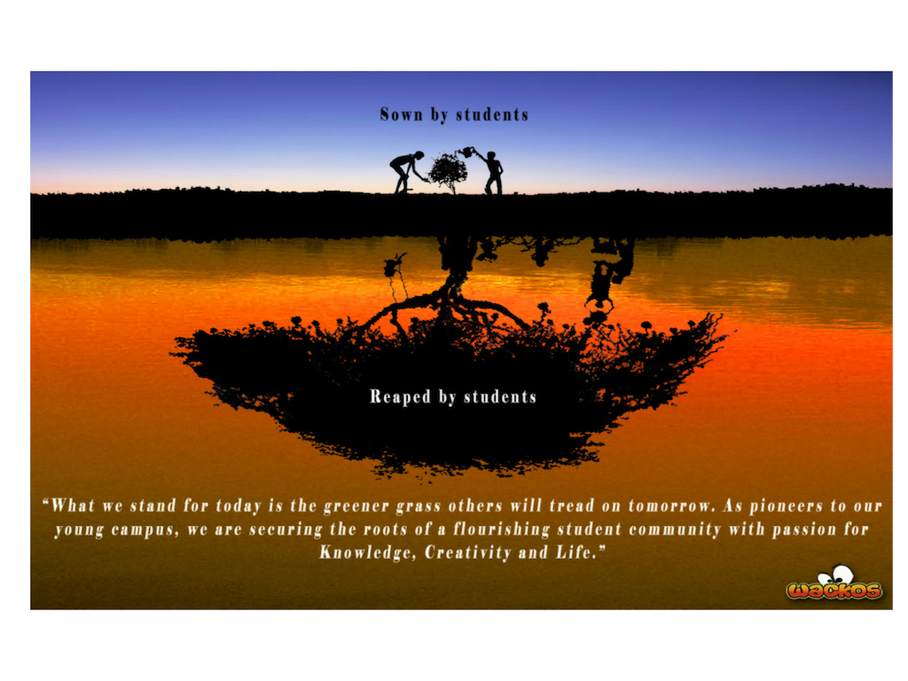
Notes:
I felt a similar satisfaction the year before, in my final year of undergraduate studies in UIA Kuantan, then a new campus for the Kuliyyah of Science.
I was part of a student-led group called the WacKOS Project.

Slide 13
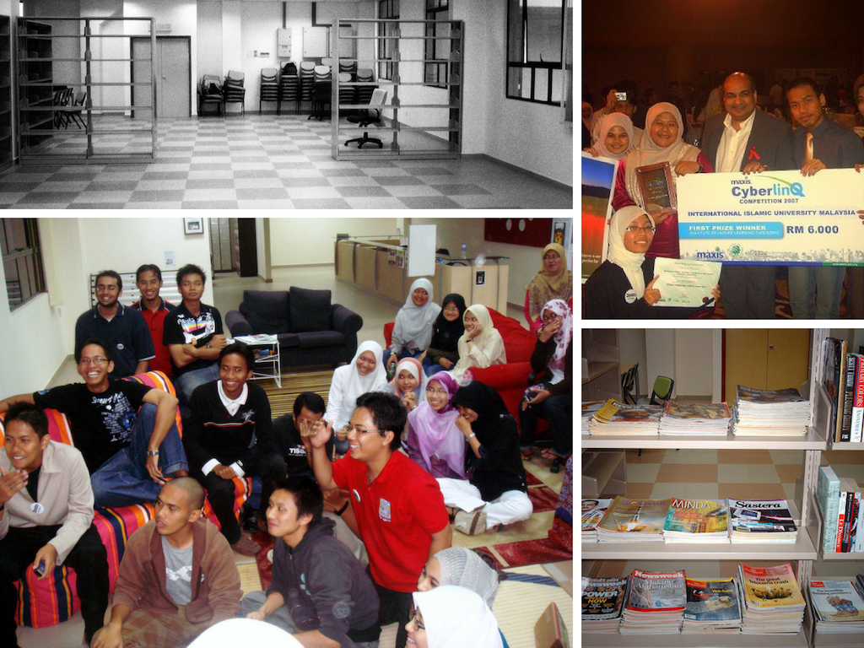
Notes:
We had won the first prize in the 2007 Maxis Cyberlinq competition for our proposal to transform an empty room into a resource center, to transform a quiet campus to a bustling one. When I became the Project Manager, I wanted to produce something that people could get excited about, and they could remember.
So we set a goal. We wanted to produce an environmentally themed play. We wrote the script. We ran auditions among the science students. We built the props and marketed the show. And we performed the play to a full house, we raised money for an orphanage, and created some lasting memories. The resource center is still being used today.

Slide 14

Notes:
I felt a similar satisfaction even earlier that year, when I wrote a complaint to the Malay Mail about the insurance company denying our claims for my late father’s policy.
You see, the modus operandi of most insurance companies is to treat all claims as fraud.
Combine this with the general inefficiencies in bureacratic processes, we spent a year submitting report after report, document after document and repeating the same statements to various staff in various departments. Worse we were made to feel as if we were frauds. All the while trying to recover from the shock and grief of losing our father.
I knew my father would not stand for this if he was alive.
So I set a goal. My goal was that my mother would no longer be harassed and my father’s intentions to provide for his family after his death would be honored.
So I crafted a complaint. The letter was published, the claims department got told off by the CEO, our claim was approved, we were able to keep the house.
I think my father would’ve been pleased.

Slide 15

Notes:
Speaking of my father, I have to say, although I may be biased, I think he was a good example of a great man. He was Holistic, Entrepreneurial, Balanced, Articulate, and one of the most thoughtful, well-read and intelligent people I knew.
He was a computer scientist. And he truly derived satisfaction from this work.
I have vivid memories of him on the floor, lying on his tummy, immersed in his codes while my small sisters took turns riding his back.
I believe he is remembered by his friends and colleagues in the same light.

Slide 16
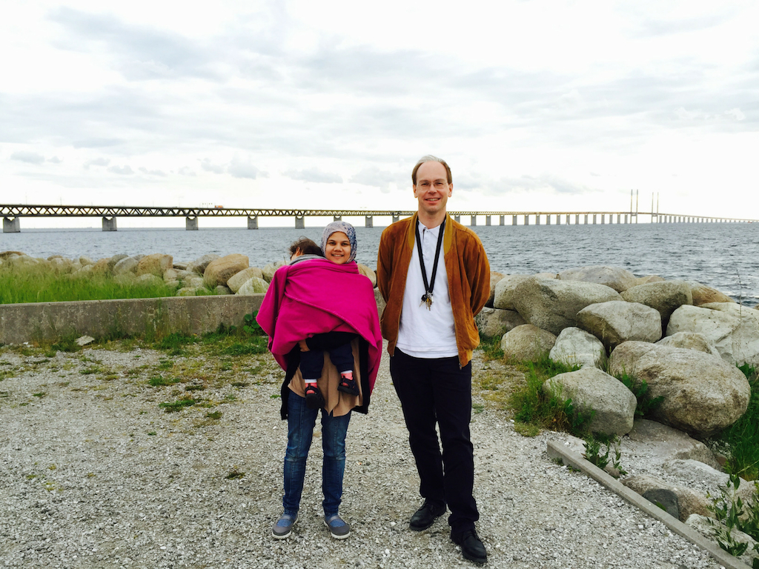
Notes:
A few years ago I finally met one of his close friends, a Swedish man named Jonas, who he knew from an attachment in Lund University in 1990. Jonas shared with me a story he sometimes told his students about his Malaysian friend, Napi.

Slide 17
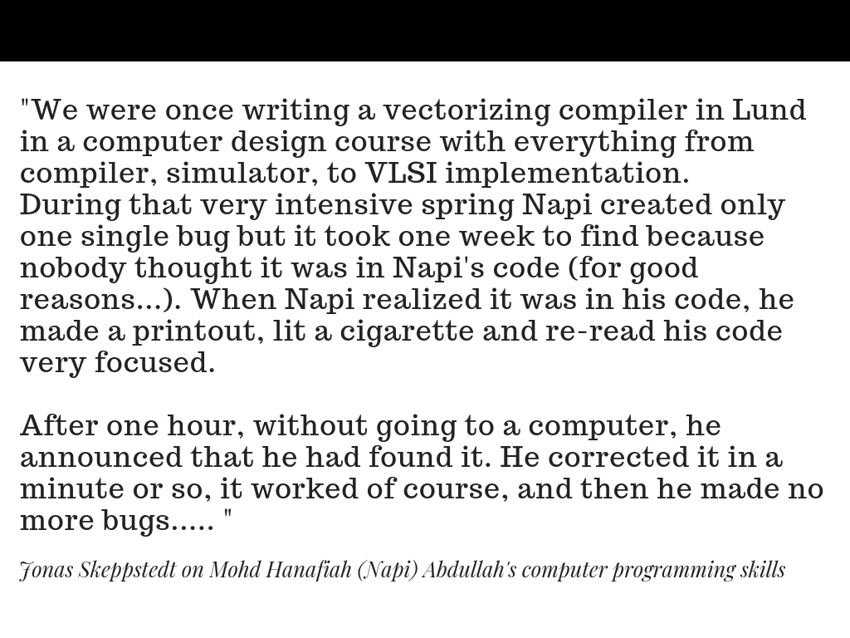
Notes:
This is the story:

Slide 18

Notes:
My father had a good job at Mimos. But he had greater goals.
So he left a secure job to start his own company called Axiomatic Solutions. The original logo of the company was three leaping dolphins, his daughter’s favorite animal.
The main product was the Axiomatic Multiplatform C to Java compiler, which he wrote.
The first few years establishing the company were difficult.
But my father always said, Nothing is difficult only more complex.
My father set a goal. So he persevered.
Unfortunately, just as the business was about to take off, and it seemed like the goal was within reach, he died from a sudden myocardial infarction at his office. He was 45.

Slide 19
Why?
Notes:
After he died, there were very dark times. Times when I questioned Why? Especially when I think about the great things he was capable and on the cusp of achieving.
After some time, I let go of this question.
But when I won FameLab, I received many messages from old friends, and even some kind strangers. But the most special messages were from people who said they knew my father and were very proud of Napi’s daughter.
It made me reflect on my life from when he died, until today.
And I remembered my question, Why?

Slide 20



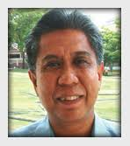
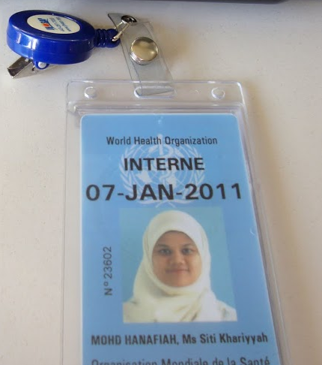

Notes:
Because my father died, I set the goal to go into research.
And I set the goal to be trained in Global Disease Epidemiology & Control.
I set the goal to go to Johns Hopkins.
These goals led me to knock on the door of Professor Zairi Jaal’s inbox, which led me to a fellowship with USM, which then led me to a fully-funded internship at WHO in Global Burden of Disease Study for viral hepatitis, which led me to a hepatitis meeting where I met my future supervisor and a PhD on tuberculosis biomarkers, which led me to a poorly made video of myself talking about tuberculosis biomarkers on YouTube.

Slide 21
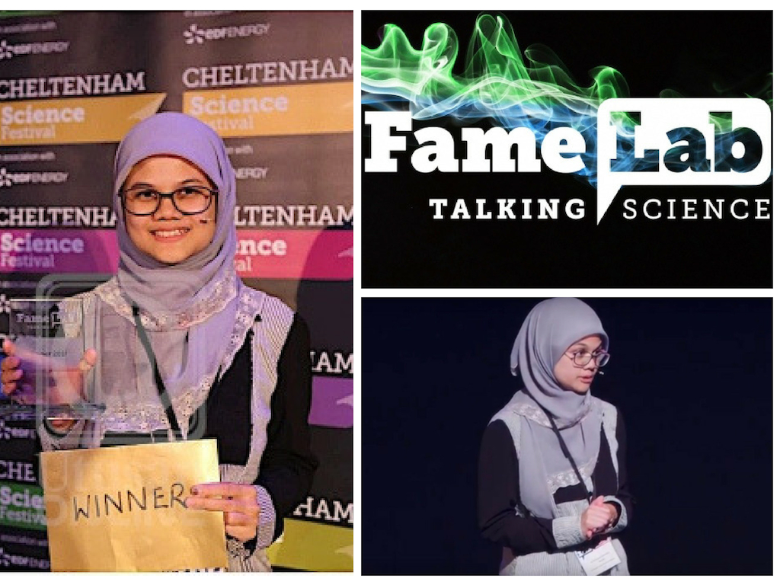
Notes:
Finally, I set the goal to win the world’s biggest science communication competition in Cheltenham. And with some effort and help from others, alhamdulillah I did.
This is the main reason I’ve been invited to talk you today, on How to be HEBAT.
But I also believe that it was my opportunity to share with you memories of a great man.
But, my embarassing disclaimer is this: I don’t have the recipe on how to be great.
But, I hope you leave today with the following three messages:

Slide 22
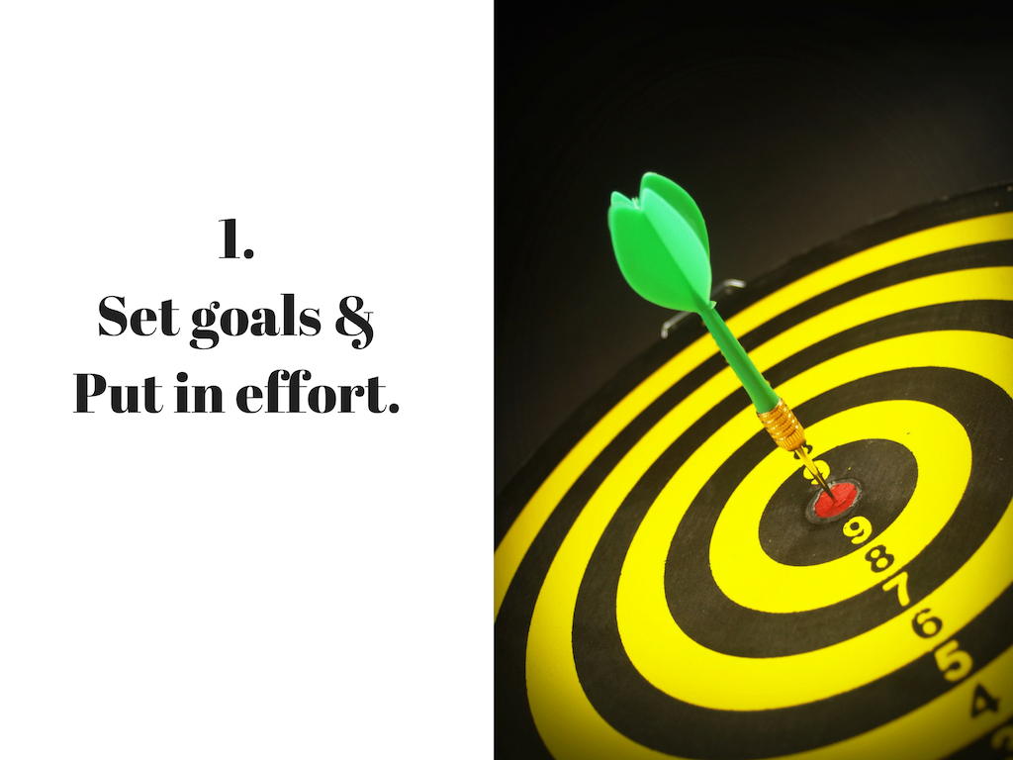
Notes:
One, Great things require first a goal and some effort. And there is much satisfaction in putting your soul and effort into achieving a goal.

Slide 23
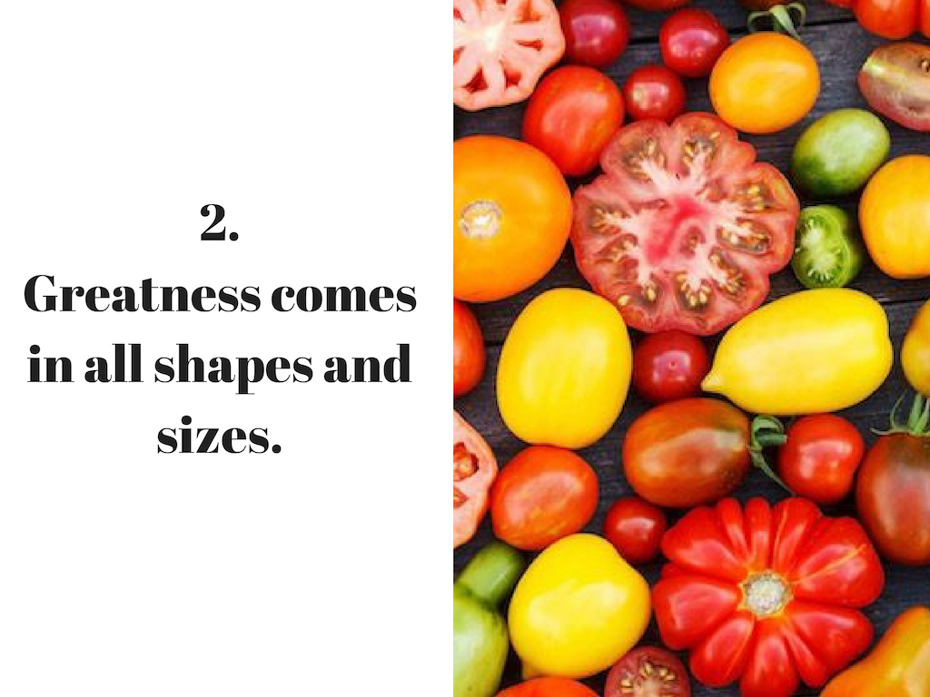
Notes:
Two, Great things can also be small things. Sometimes a silent great act that only we alone can appreciate can lead to greater acts with greater impact to those around us.

Slide 24
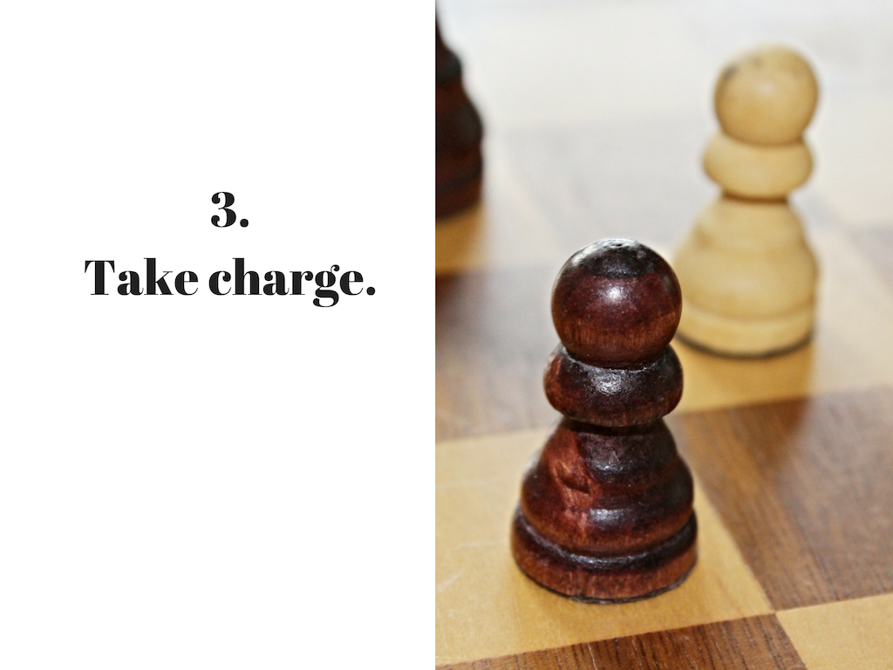
Notes:
Three, Greatness comes to the players, not the pawns. For even if there is room for greatness in destitution and adversity, a pawn may succumb to the situation. But a player will take charge of challenges and transform these into opportunities.
Anyone and everyone has the God-given capacity to do great things.
It can be as fleeting, and as insignificant as building an igloo with a few friends.
It can be as momentous as producing a play or winning a competition.
It can be as simple as writing a letter to help your family.
Some of these great things will be recognized by peers and awarding bodies and you can list them on a resume.
But some only you will appreciate—but do them anyway.
We can all be HEBAT in our own way on our own scale.

Slide 25
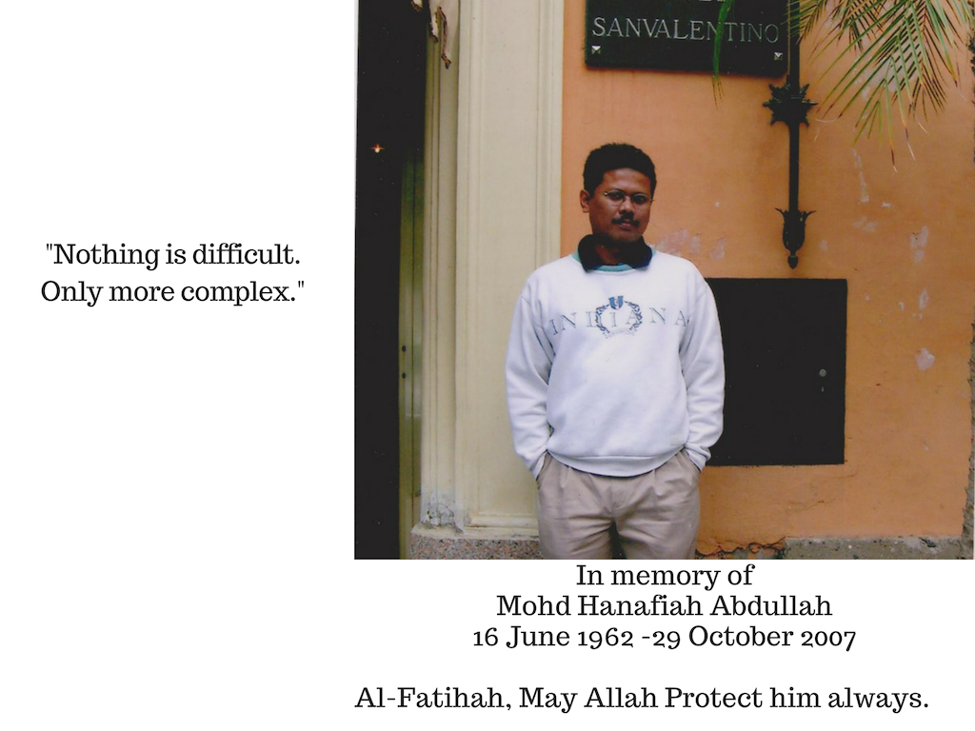
THANK YOU
Notes:
So I’m sorry, I can’t tell you exactly how to get there. But I hope I’ve convinced you to try.
Set some goals, put some effort, remember that greatness comes in all shapes and sizes, and take charge of your life.
So even if life gives you lemons, I hope you endeavour to sell some lemonade.
Even if life gives you loss, I hope you endeavour to gain.
And if ever life gives you a snowmageddon, I hope you endeavour to build an igloo. It’s really fun!

