Slide 1
HOW TO
NURTURE
A STUDENT
TO BE
A HOLISTIC THINKER?
ROSE ALINDA ALIAS,
UNIVERSITI TEKNOLOGI MALAYSIA

Slide 2
Are you a holistic thinker?

Slide 3
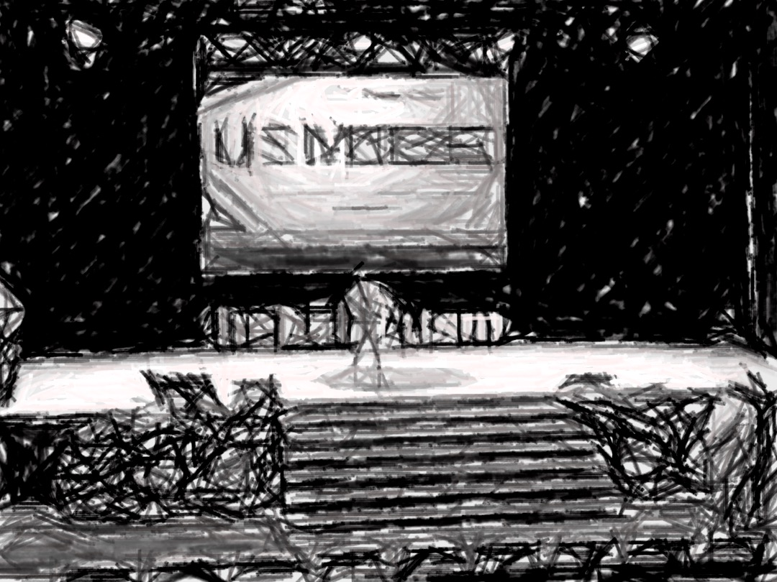
WHAT & where IS THIS PHOTO?

Slide 4
Who / what is IN THIS PHOTO?

Slide 5
Just eizaz ??

Slide 6
lights
screen
stage
boundary
monitor

Slide 7
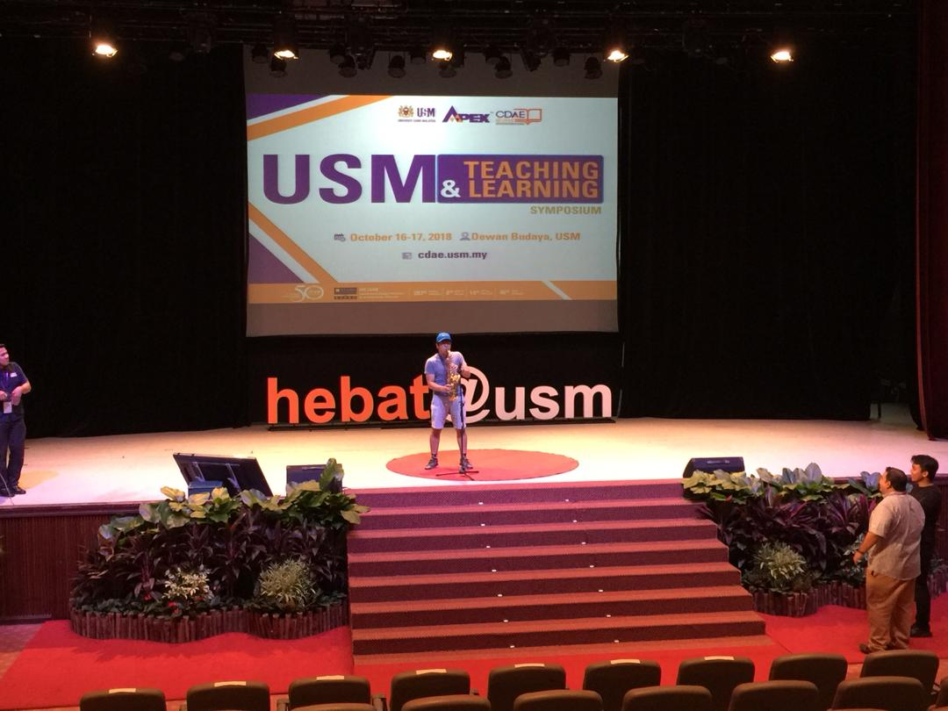
What’s the story?

Slide 8
A holistic thinker
Ability
to
the
whole
picture
see

Slide 9
A holistic thinker
Understands
the
interdependencies
of
various
component
parts

Slide 10
SPECIFIC/ANALYTIC THINKER
Sees only foreground
step-by-step
Needs to be taught
Reductionism/Decomposition
Break down the thing into parts to understand how the parts work
Assemble the parts to unerstand the whole
Focus on What

Slide 11
HOLISTIC THINKER
Sees the WHOLE
Interdependencies of object
Relationship of
background
foreground
Sense-making

Slide 12
Left VS RIGHT BRAIN
Compartmentalized thinking is “left brain” thinking.
Calculated.
Scheduled.
Scientific minded.
This is where you focus on specific topics, gathering as much data as you can to formulate your theories with. This is how our education system teaches us.
Chemistry.
Biology.
Physics.
Everything is separated

Slide 13
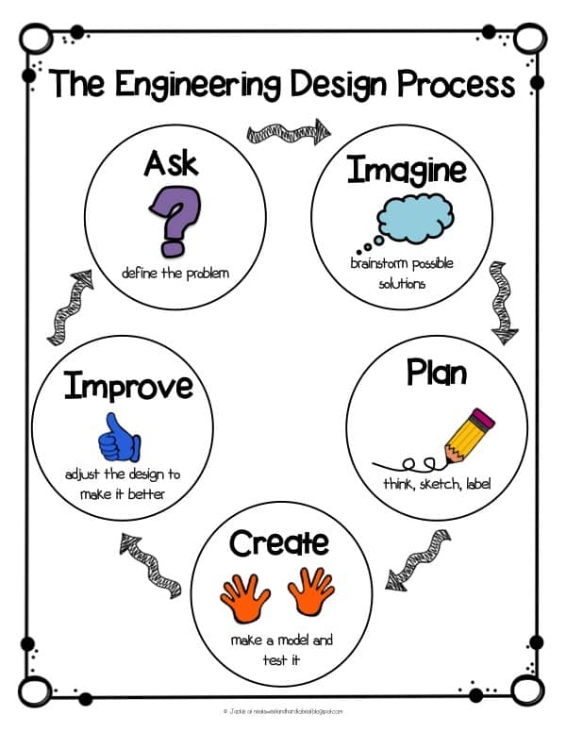
THINK LIKE AN ENGINEER?
ENVIRONMENTAL ENGINEERING
ENGINEERING EDUCATION
CIVIL ENGINEERING
MECHANICAL ENGINEERING
ELECTRICAL ENGINEER

Slide 14
THINK LIKE A PROGRAMMER

Slide 16
Thinking like a DISCIPLINARIAN
DISCOVER NEW WAYS TO GET STUDENTS THINKING ACROSS CURRICULAR AREAS

Slide 17
LEARNING INNOVATION SPECIALIST

Slide 18
THINKING TOOLS

Slide 19
A Future Ready Curriculum
Curriculum Structure:
Fluid & Organic
Learning Delivery: Transformative
CONSTRUCTIVE ALIGNEMNT
Alternative Assessments
Future Proof Graduates

Slide 20
HOW TO NURTURE A STUDENT TO BE A HOLISTIC THINKER?

Slide 21
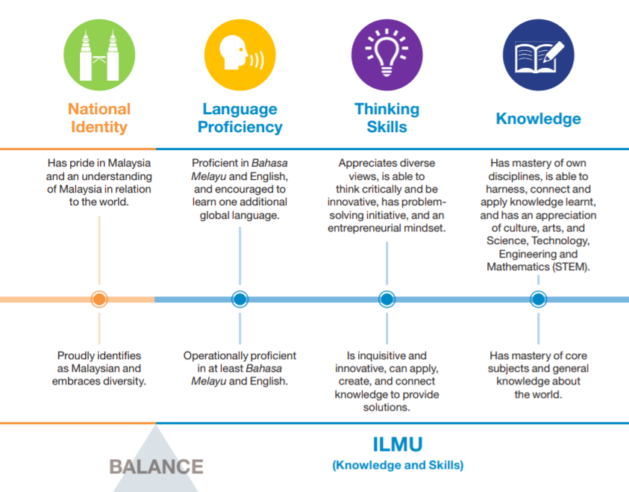

Slide 22
A Future Ready Curriculum FOR PRODUCING FUTURE PROOF TALENTS
Curriculum
Structure:
Fluid & Organic
Learning
Delivery:
Transformative
CONSTRUCTIVE ALIGNEMNT
Alternative
Assessments
Future Proof Graduates

Slide 23
NURTURING A HOLISTIC thinker Through fluid & organic cullriculum structure
Convergent,
Multi/Inter/Trans Disciplines
Flexible & non-conventional
Industry Partnership
Global

Slide 24
NURTURING A HOLISTIC thinker Through immersive experiential learning
Learning through doing and integration.
2U2i
Gap Year
Community engagement
Service learning
Virtual reality
Augmented reality

Slide 25
NURTURING A HOLISTIC thinker Through AUTHENTIC assessment
The application of criteria related to the construction of knowledge, disciplined inquiry & the value of achievement beyond the classroom learning context.
Emphasises on the contextualised task
Example: Portfolio-based assessment

Slide 26
NURTURING A HOLISTIC thinker Through Performance-based assessments
Measure students’ abilities to apply the knowledge & skills which they have learned.
Gathering relevant feedbacks from others.
The application of real world scenarios in eliciting & strengthening student critical thinking, problem-solving, self-evaluation & HOTs.

Slide 27
NURTURING A HOLISTIC thinker Through Personalised assessment
Measures the students’ readiness to be assessed.
Flexibly & adaptively in terms of assessment time & questions structure in measuring the achievement of learning outcomes.
Students are more responsible in their own learning processes.
Example:
pre-recorded lessons are made available on YouTube.
Assessment material & resources to be reachable at anytime & anywhere.

Slide 28
NURTURING A HOLISTIC thinker Through Integrated assessment
Interdisciplinary approach.
Engaging & creative learning platform that connects students with the real-life situation.
Integrate the summative & formative evaluations through the provision of meaningful data.
Example: Capstone projects & the integration between iCGPA & portfolio-based assessment.

Slide 29
NURTURING A HOLISTIC thinker Through Contemporary assessment
Focus on multi aspects:-
students’ mastery of knowledge,
skills & values that will enable them to function in the gig economy.
Example:
apprenticeship model, presentation, project-based, case-based, take-home & oral examination.

Slide 30
NURTURING A HOLISTIC thinker Through Real-time assessment
Instructors to analyse students’ mastery of contents & skills during the learning process.
Adjust the learning approaches appropriate to the students level of understanding.
Example:
observation, thinking aloud & diagnosing students’ strengths & weaknesses.
Survey to assess students’ competencies & deficiency

Slide 31
NURTURING A HOLISTIC thinker Through Challenge-based assessment
Emphasise collaboration, cooperation & group competition.
Example:
‘Hackathon’ for coding & programming competition.

Slide 32
NURTURING A HOLISTIC thinker Through Profiling assessment
Analyse students values, interests, preferences, basic English proficiency test as well as basic computing test.
The outcome is the students’ holistic profile including their academic motivations.
Assist the students in appreciating & interpreting their competencies

Slide 33
CURRICULUM 4.0:
A FUTURE-READY CURRICULUM FRAMEWORK
Transformative Learning & Teaching Delivery
Industry Partnership
21st century pedagogies (heutogogy, paragogy, cybergogy)
Futuristic Learning Spaces dan Technology 4.0 in Learning
Alternative Assessments
* Examples
Authentic
Performance-based Personalised
Integrated
Contemporary
Real-time
Challenged-based
Profiling
Immersive Experiential Learning
Global
Flexible & non-conventional
Convergent,
Multi/Inter/Trans
Disciplines
Fluid and Organic Curriculum Structure
Element
Sub
Element

Slide 34
